Slide 1

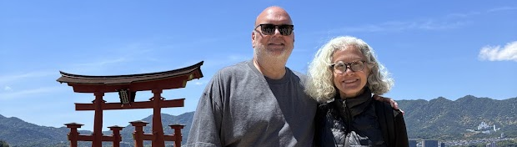
Sabbatical Revelations
Steven L. Thomason
Saint Mark’s Cathedral
September 9, 2026
Notes:
Floating Tori Gate, Miyojima Island, Southern Japan.

Slide 2
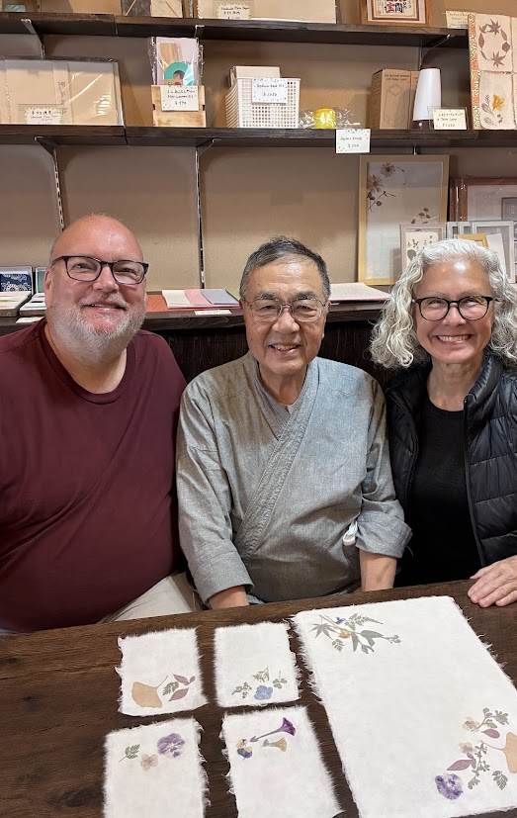
What is a sabbatical?
Ancient rhythms—sabbath, sabbatical, jubilee (renewal, restoration)
  Our diocese provides for sabbatical every five years
Three key elements typically included in Ministry Sabbaticals:
A time for personal relaxation.
A time to pursue personal interests.
A time of renewal around things that will directly benefit the congregation.
Gratitude
for the opportunity!
Notes:
Alban Institute: “time to do what you would not normally do”
Washi paper-making with Hiro, who learned in the mountains of Honshu

Slide 3
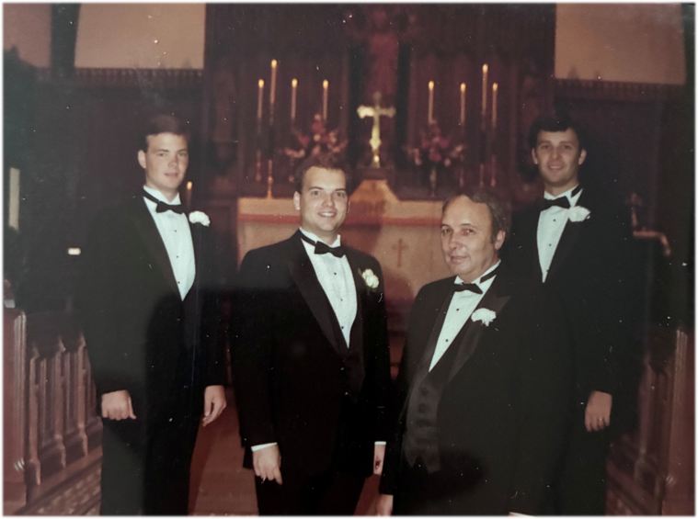
The Original
Overarching Vision for this Sabbatical
1) time for rest, renewal and striking different contemplative rhythms of daily life,
2) exploring the familial and generational contexts which have shaped my life and my spouse’s, and our siblings and children in known and largely unknown ways, and
3) diving more deeply into congregational systems to better understand some of the patterns of growth cycles, conflict, and disruptive leave-taking with an eye toward my own retirement in 4-6 years as an opportunity for life-giving transition and good things for the cathedral parish.
Notes:
My father’s death in Dec. 2024 unleashed new things…
And I am not yet to retirement, but thinking about it. I want to leave well!!!
Photo: wedding 41 years ago

Slide 4
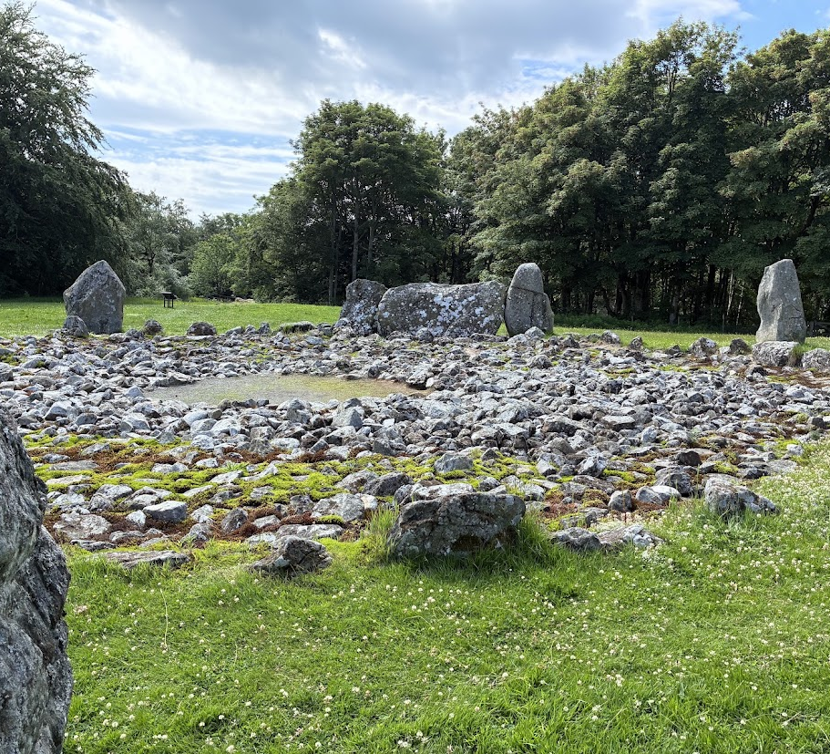
The “Lived Into”
Overarching Vision for this Sabbatical
1) time for rest, renewal and striking different contemplative rhythms of daily life,
2) exploring the familial and generational contexts which have shaped my life and my spouse’s, and our siblings and children in known and largely unknown ways, and
3) (Re)discovering the deeply held human need to “belong” in ways that are vulnerable, life-giving, evocative of gratitude, and transformative.
Notes:
Less an academic or cerebral exercise as it was a heart experience—recognizing that family and community are, in their essence, about belonging, which is a deep human need.
Neolithic (~2000BCE) stone circle, Loanhead of Daviot. With cemetery/funeral pyre circle adjacent.
The people who worshipped here help hold the space for us to recognize it is sacred, and we are connected!
Sabbatical was about exploring and discovering connections…

Slide 5
Benedictine Patterns of Life
Stability
Obedience
Conversion of Life
Opening into
Transformation &
Renewal
Finding God in
the current situation
Being faithfully
present
Notes:
Stability: “accepting this particular community, this place and these people…as the way to God.” (finding God in current situation)
Obedience: “a lifelong process of learning…listening to the Word of God, to the Rule, t the brethren and to the Abbot” in order to act. (being present faithfully)
Conversion of Life: “a commitment to total inner transformation” as we turn to Christ. (opening into renewal/transformation)
-from Ester de Waal’s Seeking God.
Rowan Williams: “

Slide 6
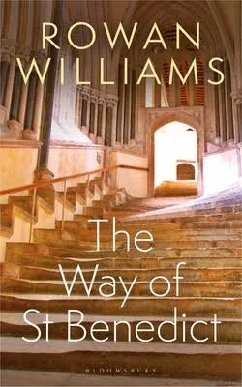
Rowan Williams: The Way of Benedict
“The community that freely promises to live together before God is one in which both truthfulness and respect are enshrined. I promise I will not hide from you—and that I will also at times help you not hide from me or from yourself…”
Notes:
How do we find community…stability…a sense of belonging
We missed this community and its worship terribly!

Slide 7
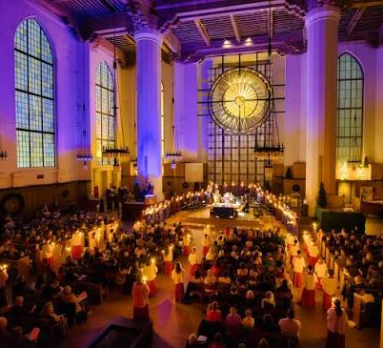
Stability: Belonging in Community
Rowan Williams: “Without the promise, the temptation is always for the ego’s agenda to surface again, out of fear, that I shall be abandoned if the truth is known…No one is going to run away; and the resources of the community are there on my behalf.”
Notes:
Photo of Pageant of the Nativity…telling the story of belonging—family, community, humanity.
Also tells the story of this community, incarnationally with our best hopes for ourselves, each other and the world, all guided by a God who relentlessly claims us (belonging)

Slide 8
Brene Brown:Wholehearted Living
Vulnerability
Belonging
Gratitude
Worthiness
Wholehearted Living
Notes:
we can’t arrive at perfection by simply accumulating the right data, or making the right decisions. Scarcity-bound cultures that always over-emphasize:
shame ("I'm never good enough"),
comparison ("How do I measure up?"), and
disengagement ("I can't care too much or I'll get hurt").
belonging is central to whole-hearted living—that we all long to belong…to feel connected to something larger than ourselves. It is an irreducible need for all humans.
Brene Brown: “True belonging never asks us to change who we are. True belonging requires us to be who we are.”

Slide 9
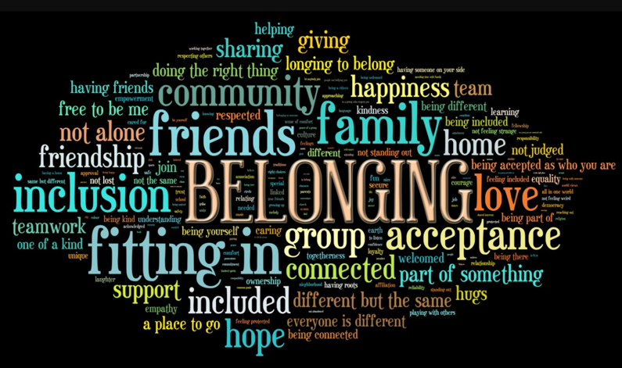
Belonging
What does “belonging” mean to you?
How would you frame it in your life?

Slide 10
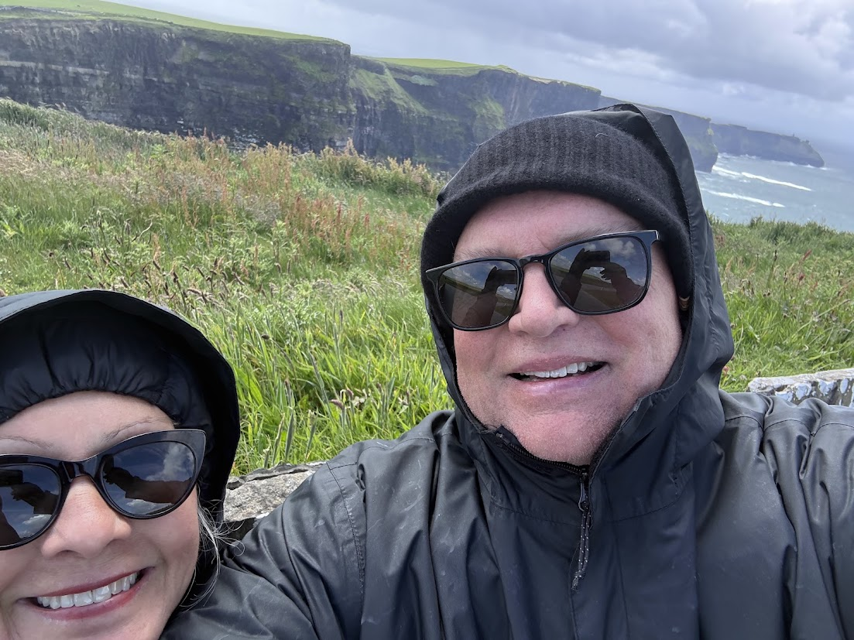
Belonging
45 years together (41 married)—sabbatical affirmed we really like spending time together!
Cliffs of Moher, Ireland
Notes:
Cliffs of Moher, Ireland
Daily rhythms of prayer, walking, meals, rest, unrushed conversations
Considerations of what retirement might look like—we like spending time together!
Belonging to/with Kathy, but much broader considerations on sabbatical—
Biological family (adoptive/chosen family)
SMC community
Ancestral connections
Humanity across time and space
All of creation (of which we are a part)—The Forest Unseen; Reconsider the Lilies.
God

Slide 11
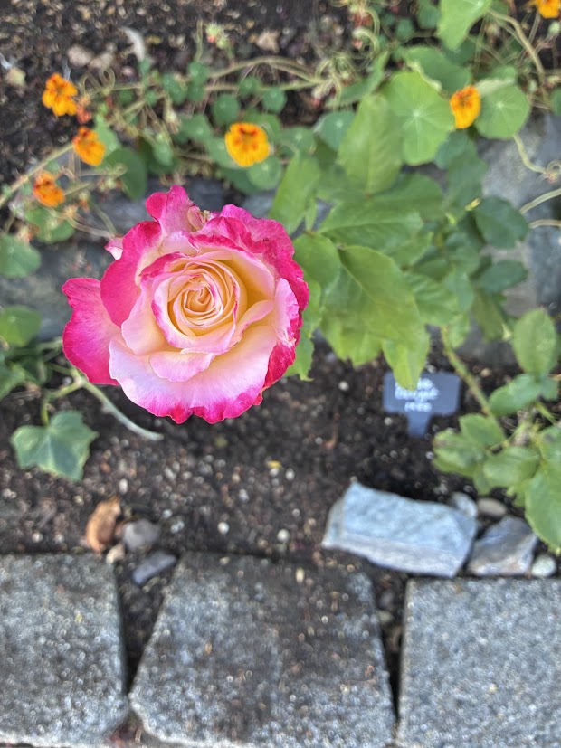
Tracing our roots and connections:
Sabbatical
Travels
Austin (clergy colleague group)
Japan (Kathy’s mother’s birthplace)
Walking in the Cotswolds
Ireland with siblings
Scottish Highlands with Kathy
California (grandkids)
Seattle (beginning, middle and end)
Returning
Home
Notes:
Traveled on three continents as we traced “belonging” but then were home at beginning, middle and end.
Double delight rose’s first bloom at the deanery.

Slide 12
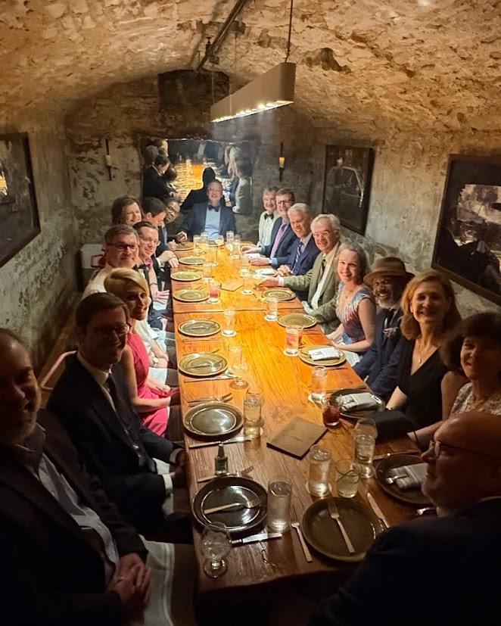
Austin in April—Clergy Group
Notes:
Old Storehouse/grotto/speakeasy at La Condesa

Slide 13
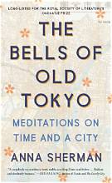
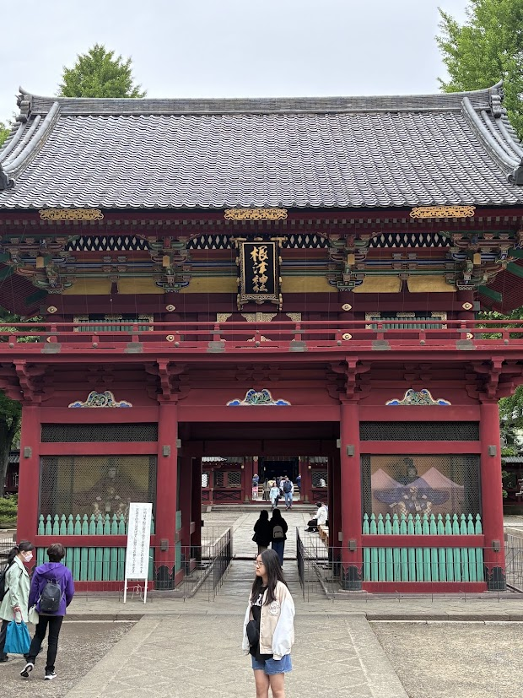

Japan in late April/early May
Notes:
Senso-ji temple in Tokyo

Slide 14
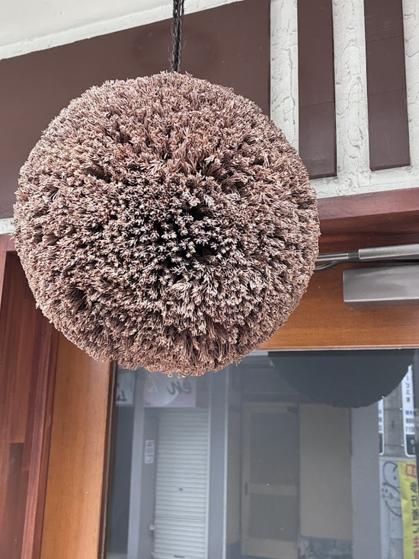
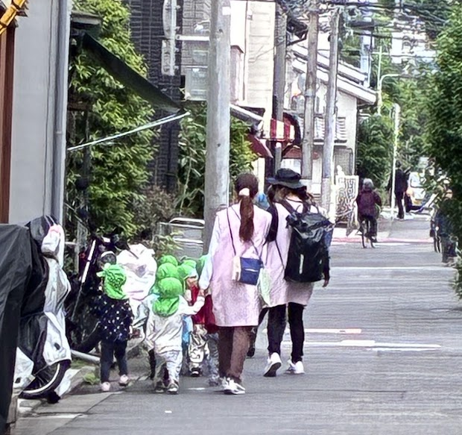
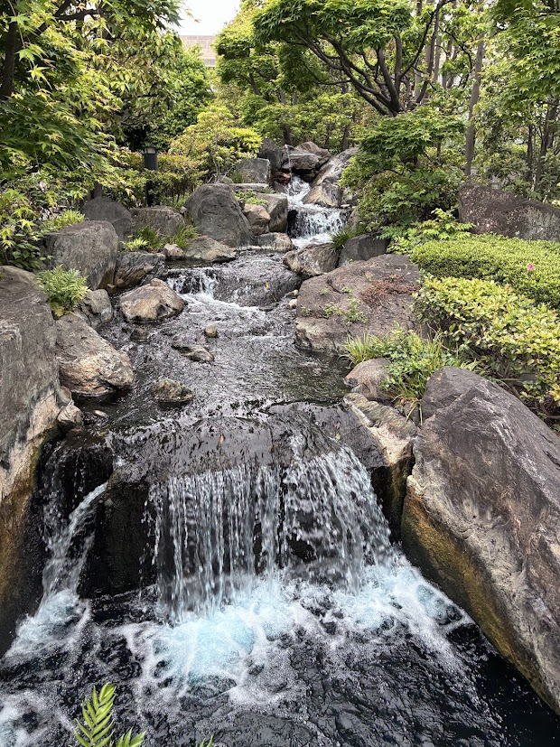
Tokyo Sites and Sounds
Notes:
Late April, off to Japan (first time for me, second for Kathy).
Sugidama--Cedar ball noting sake production (connection to nature, perfection)
Preschool children
Grade schoolers go to school on their own, take the train, etc.
Water is important sacred symbol—purity/purification, flowing of time/change, etc.

Slide 15
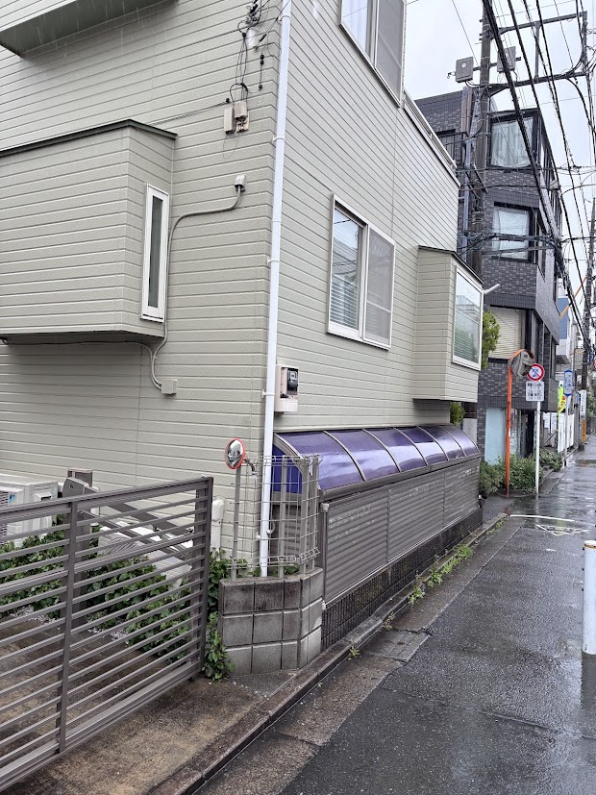
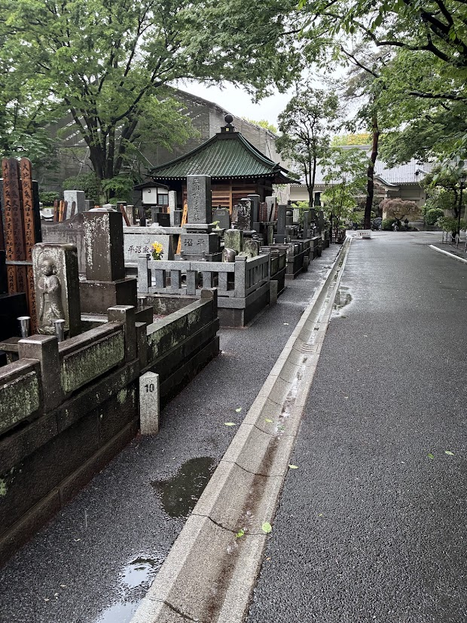
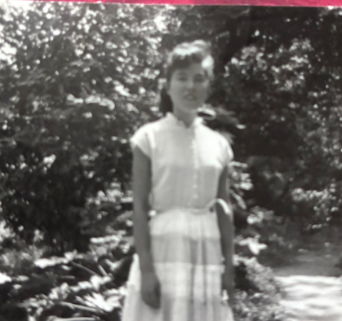
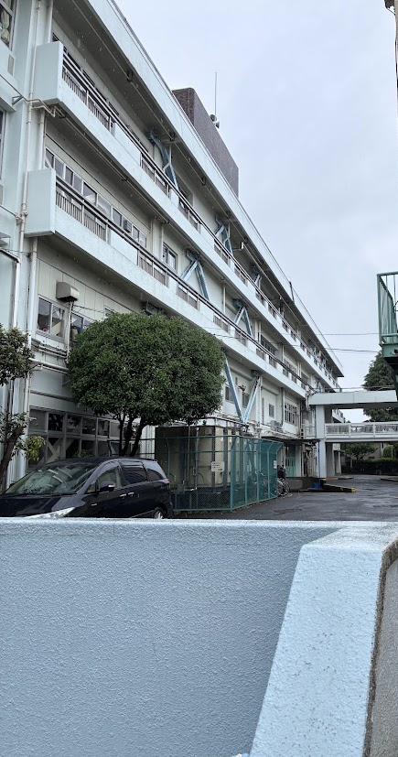
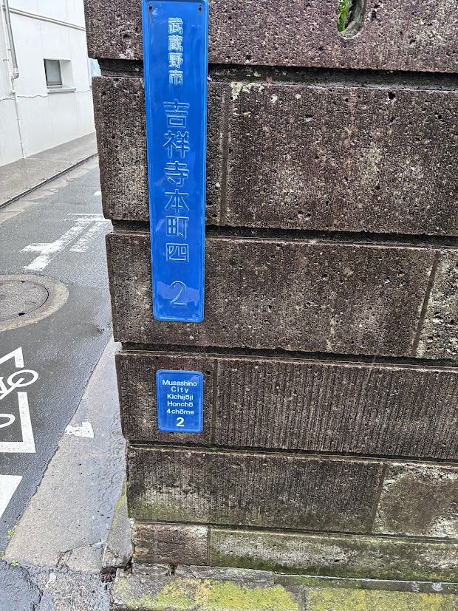
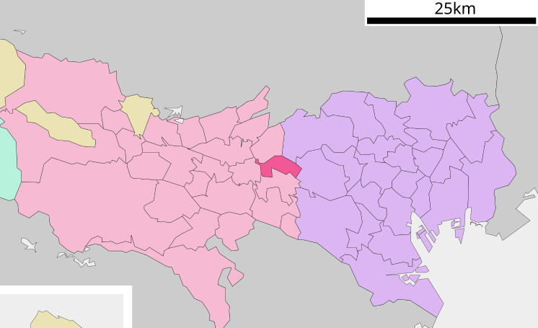
Mushashino
Notes:
Mushashino City, western Tokyo.
Koseki—parents moved there after 1923 earthquake and fires in Tokyo
Firebombed in WWII—plane factory there
Kobe went to school there
Kathy visited her grandmother in 1970s
Tried to find the cemetery nearby where her grandparents might be
All sacred journey on a rainy day (only one for who trip to Japan)

Slide 16
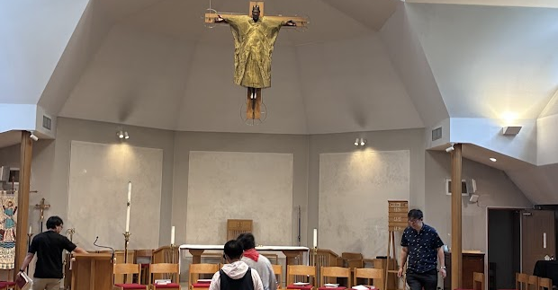
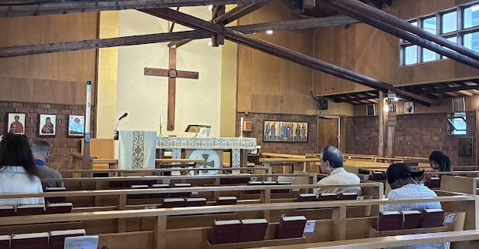
Churches visited
St. Andrew’s Cathedral, Tokyo
St. Alban’s, Tokyo
Notes:
Sister churches side by side. One native-speaking, the other English.
St. Alban’s was packed with a diverse assembly.
Family of African ex-pats with three kids, one laid down to sleep, the older two came to sit with us, followed our lead…belonging to some larger than ourselves
--got an email the next day from Tom and June Grant

Slide 17
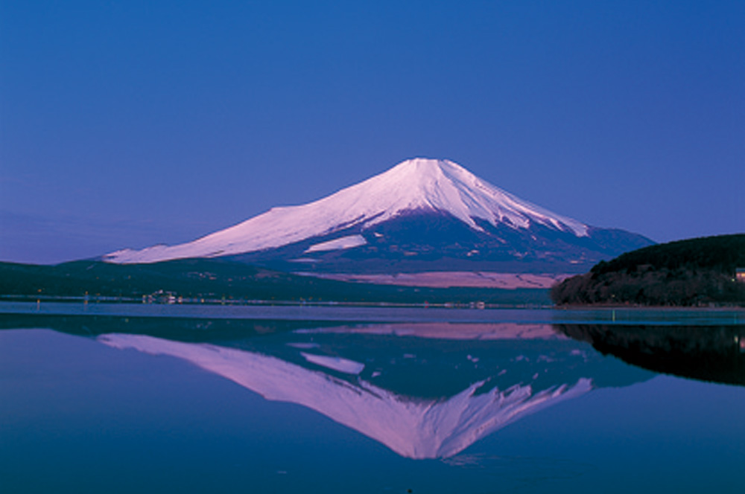
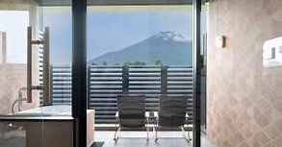
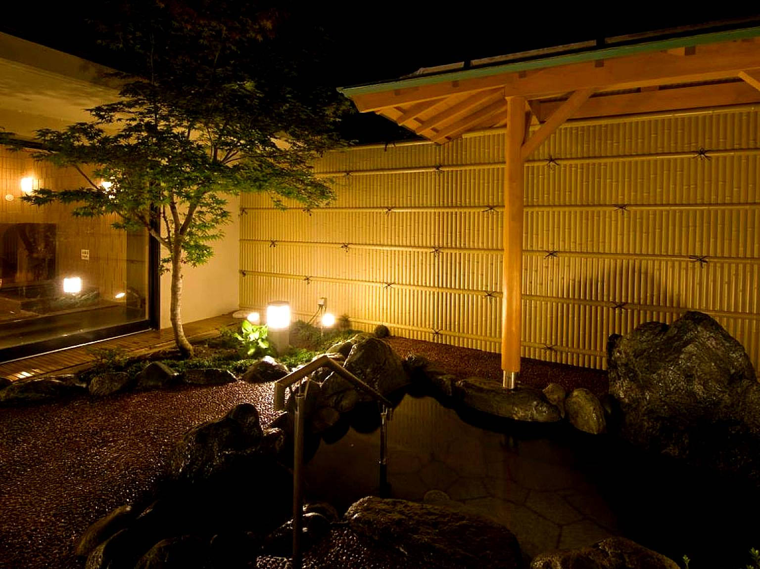
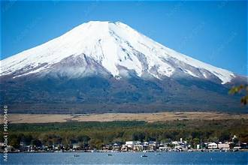
Mt. Fuji, Lake Yamanokako and Ryokan
Notes:
Ryokan—hotel or inn with onsen bath
Ours was beside Lake Yamanokako, looking up to Mt. Fuji

Slide 18
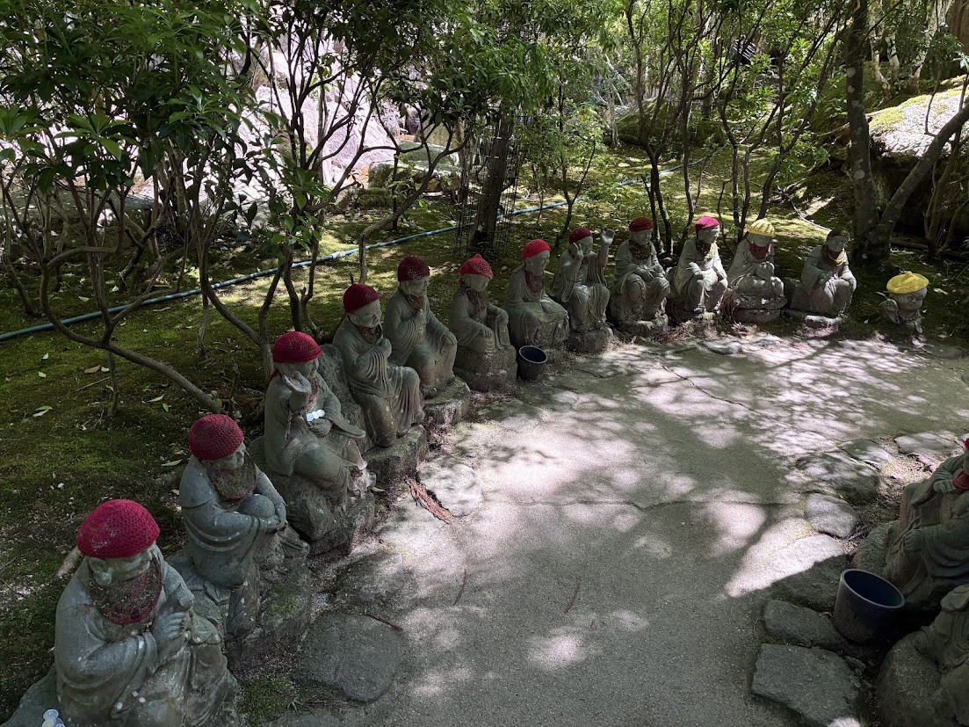
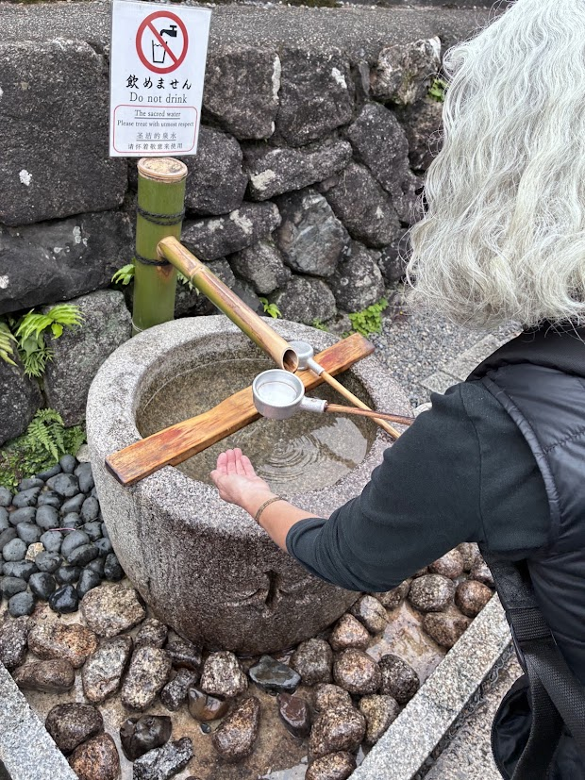
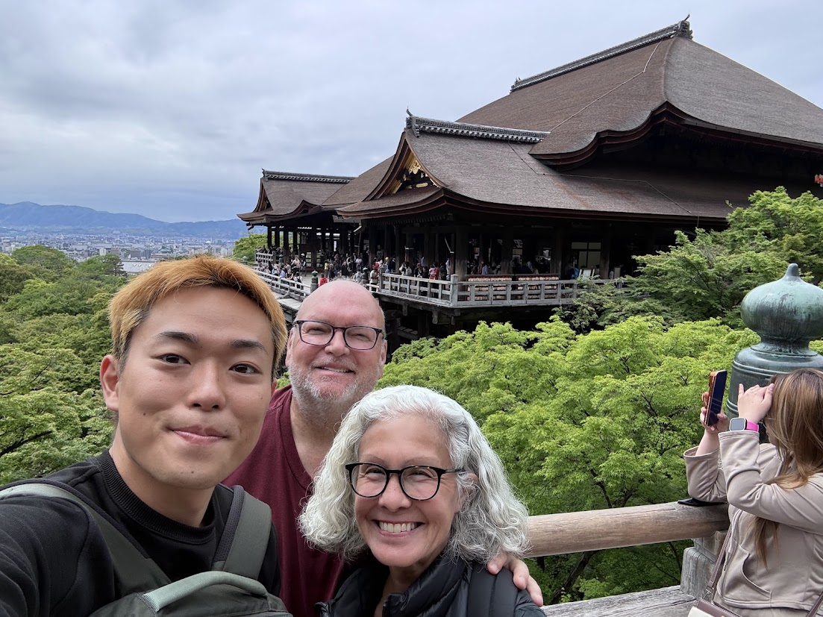
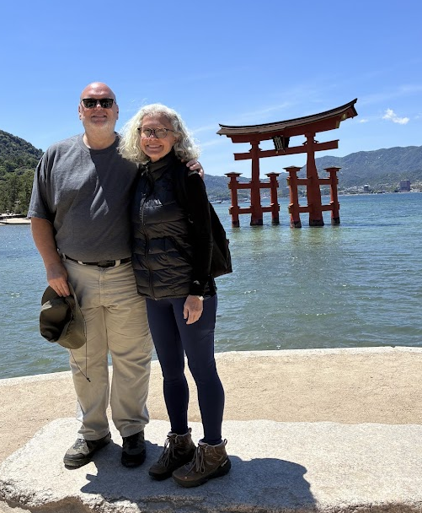
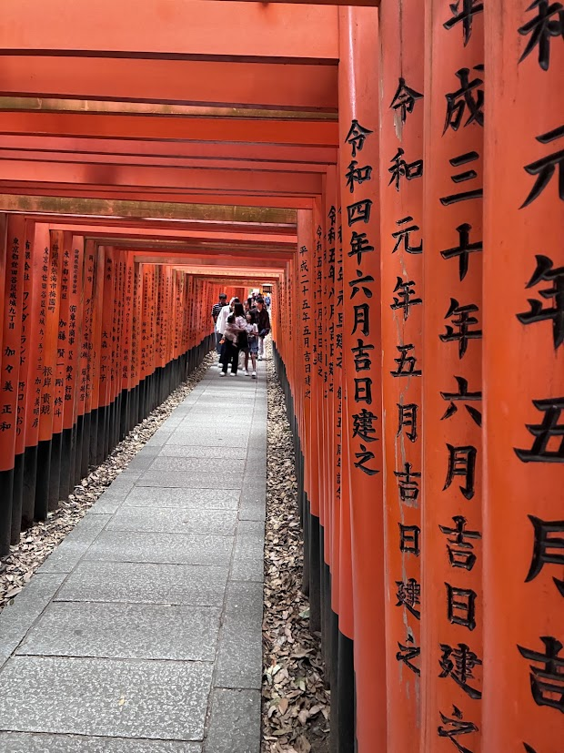
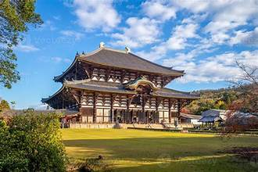
Kyoto, Nara, and Hiroshima
Notes:
Kathy’s mother was Shinto, Buddhist, Catholic, Pentecostal, de facto Episcopalian….
Buddhist—quiet entry, bowing, shoes off, make offerings. Washing Sequence:
First, pour water over your left hand.
Then, pour water over your right hand.
Next, take a sip of water to rinse your mouth (do not swallow).
Finally, rinse the ladle handle before placing it back in the basin.
Shinto (see next slide)—clap to awaken the kami (deities)—communicate with them, respectful call to kami (shared practice, community)
Kathy doing ritual washing for Buddhist temple in Kyoto
Kiyomizu-dera Temple in Kyoto (means “pure water monastery”)—with Yujiro our guide
Fushimi Inari Shrine--Thousand Tori Gates in Kyoto
Todaiji Buddha Temple in Nara (bottom left)
Floating Tori Gate-Miyojima Island
500 Buddhas with knit caps Daisho-in Temple, Miyajima Island

Slide 19
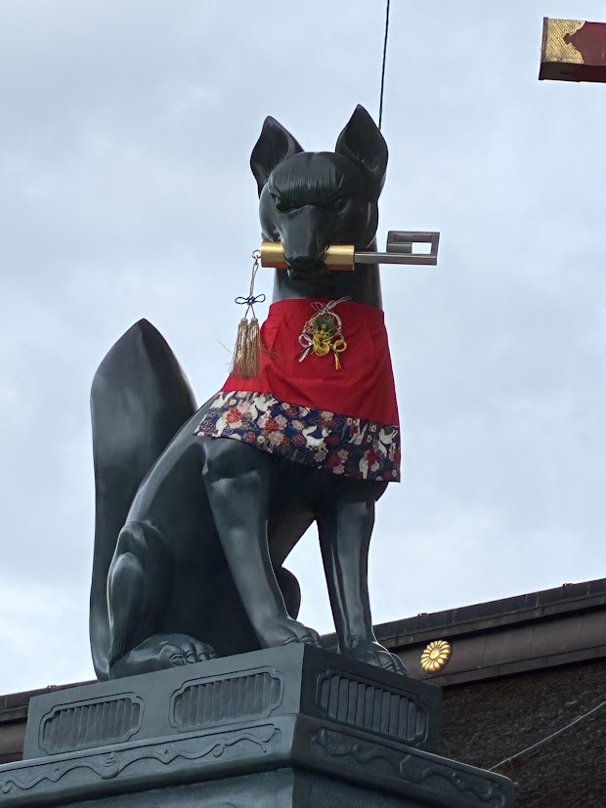
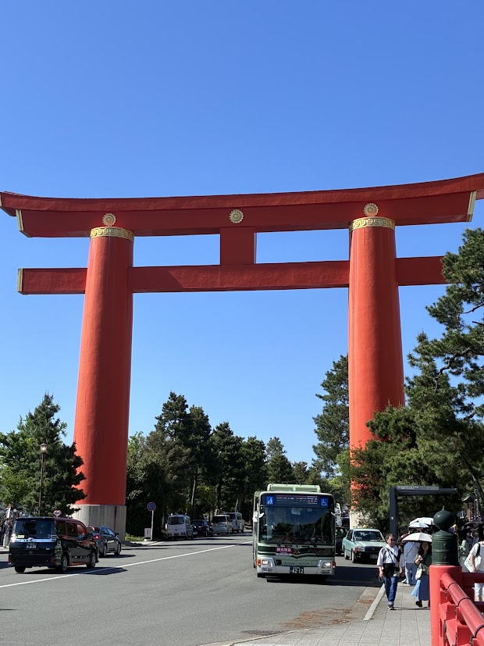
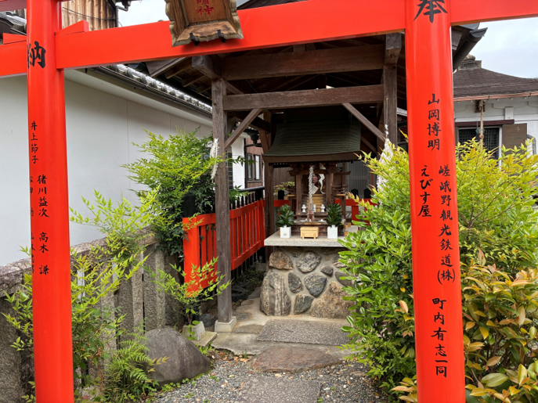
Features of Shinto Shrines
Notes:
Shinto—animistic religion, kami (gods), more than 100,000 public shrines in Japan, many homes have theirs also.
Often syncretized with Buddhism, but there are distinct features
Shinto shrine: Loud bell allows gods to know you are present, bow twice, clap twice with hands right hand lower than left hand (right=humans and left=gods) (clap awaken gods)lower hands to side and bow when finishing prayer.
bow tori gate (which are only at Shinto shrines) entering and leaving.
Foxes. Because foxes eat rats that eat rice.
Inari shrine is top Shinto shrine. For prosperity in business and good rice harvest.
Vermillion color used because evil spirits don’t like that color.
Buddhist—quiet entry, bowing, shoes off, make offerings. Washing Sequence:
First, pour water over your left hand.
Then, pour water over your right hand.
Next, take a sip of water to rinse your mouth (do not swallow).
Finally, rinse the ladle handle before placing it back in the basin.

Slide 20
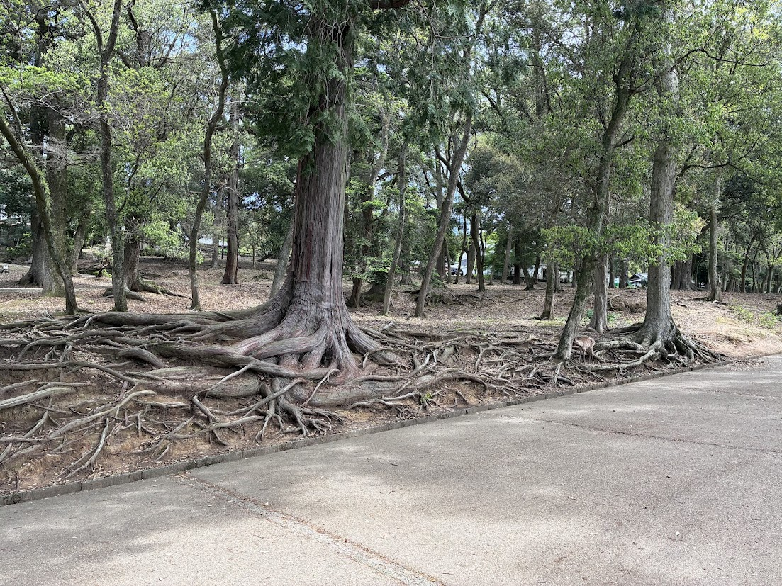

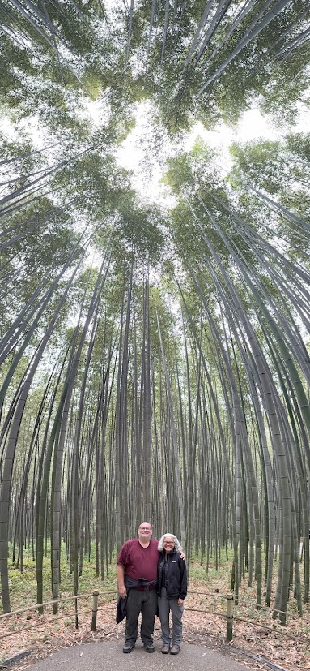
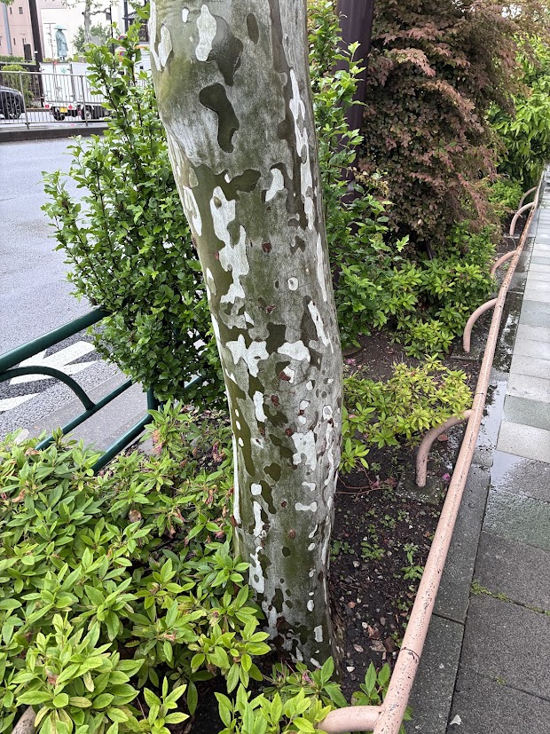
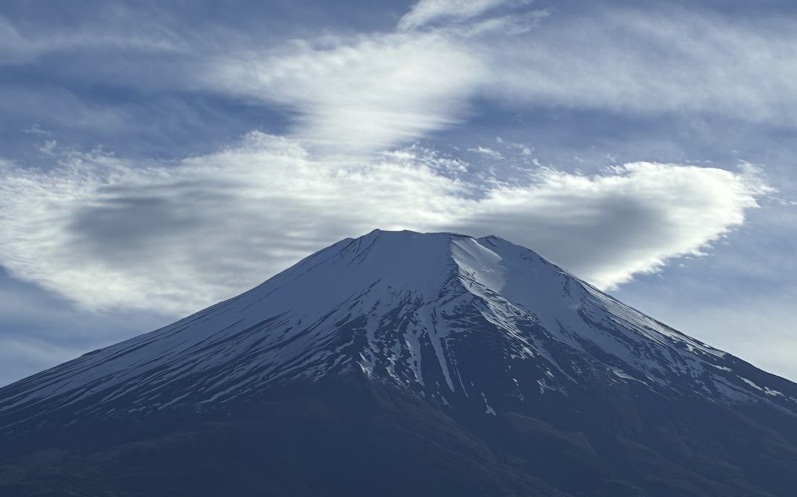
Japan’s Natural Beauty
Notes:
Belonging to natural world also
Tree roots at Nara (wild deer)
Mt. Fuji from our room
Sunset from our hotel room in Kyoto
Interesting tree bark on city street
Bamboo forest in Kyoto

Slide 21
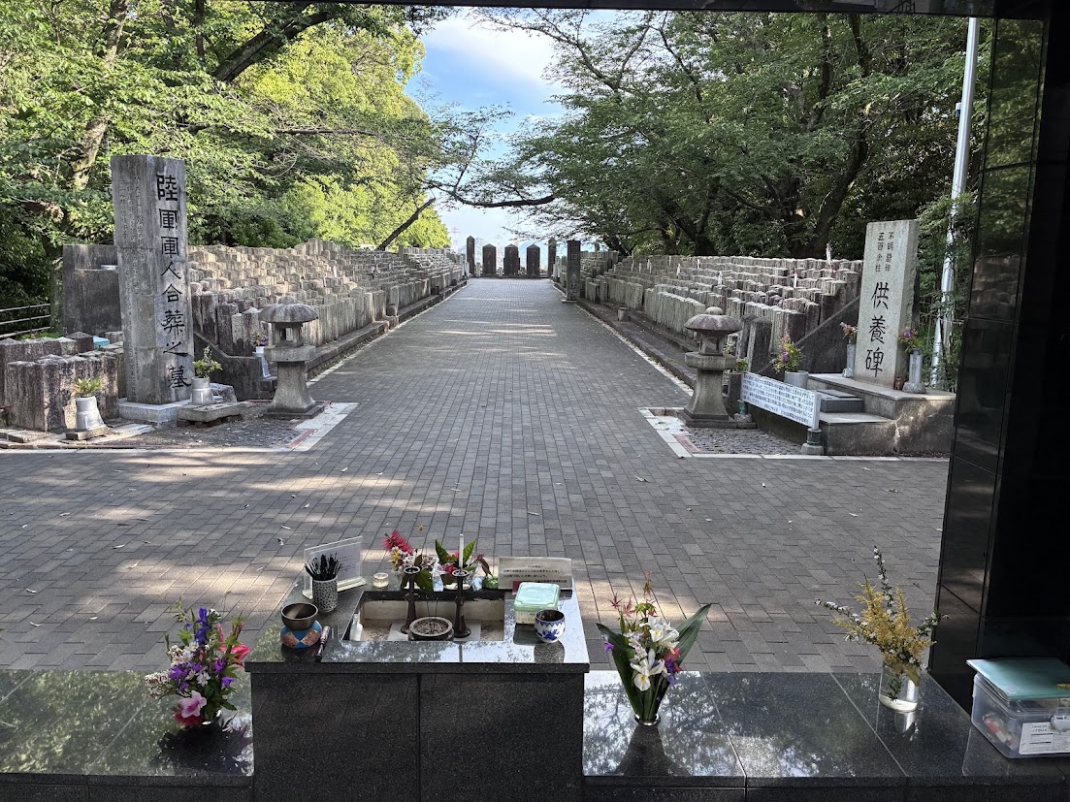
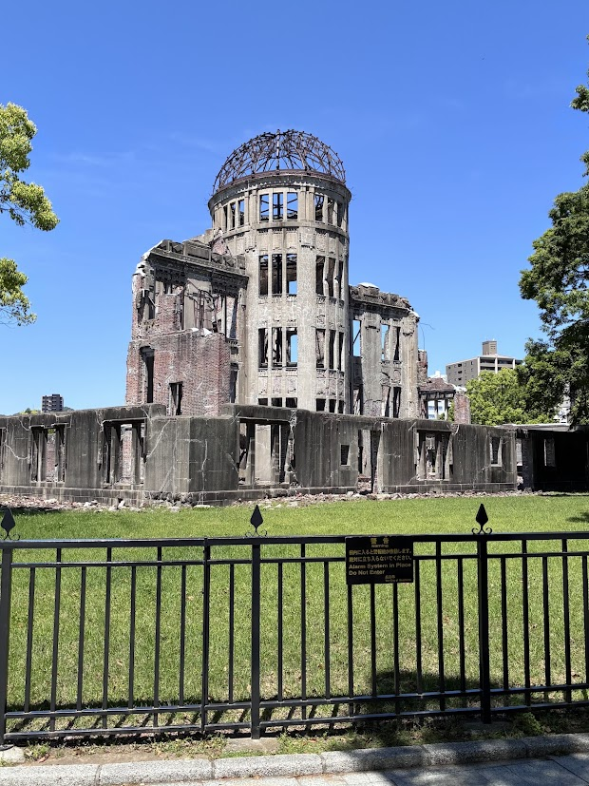
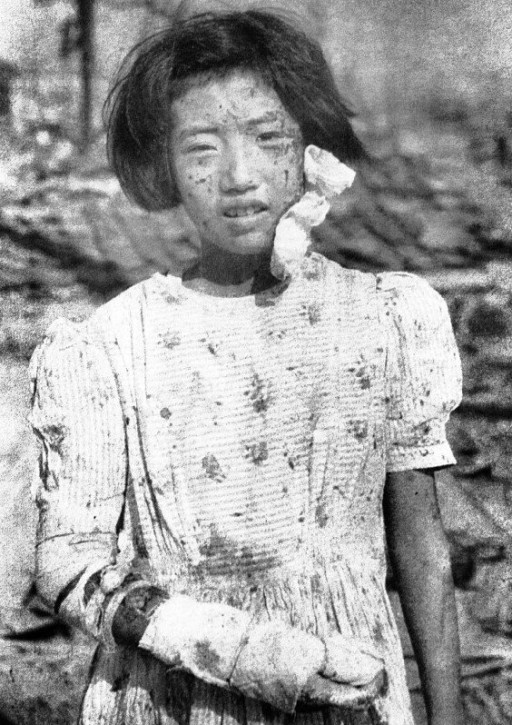
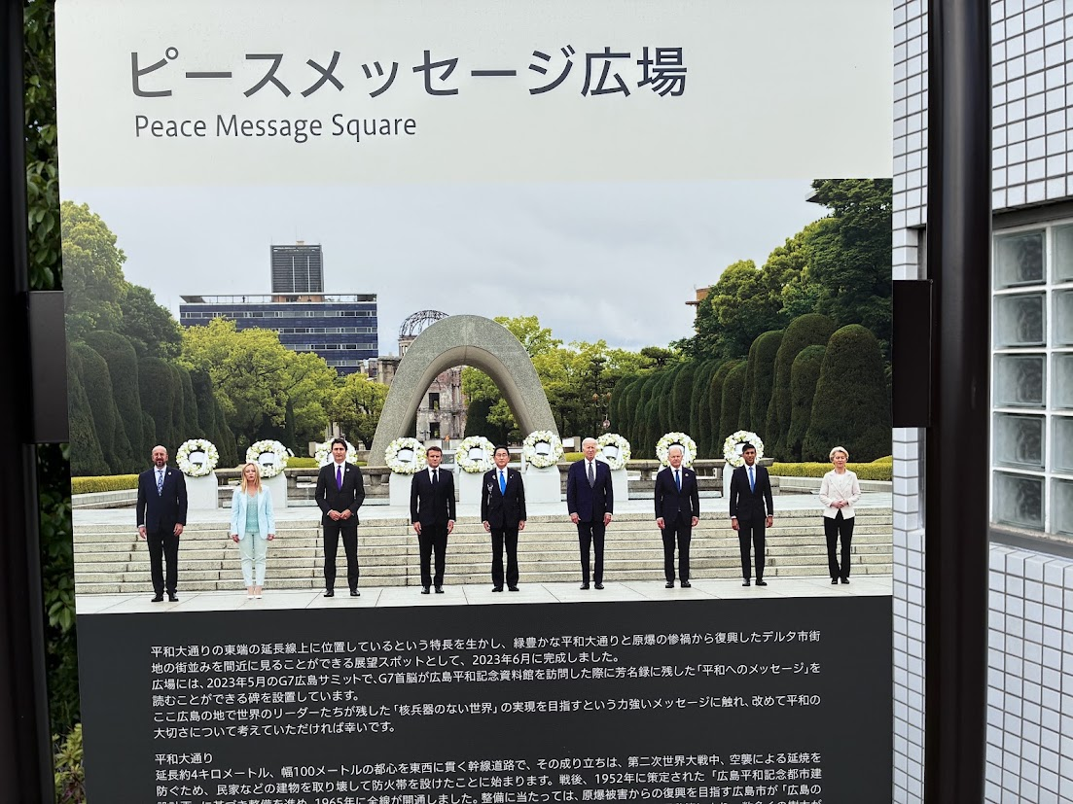
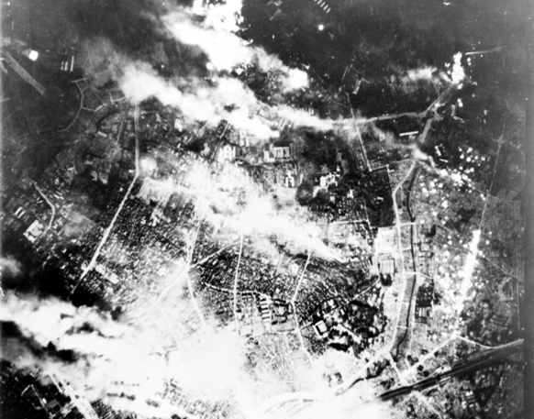
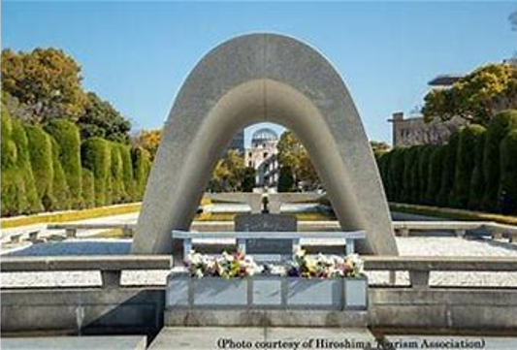
The Weight of War
Notes:
Hijiyama Military Cemetery in Hiroshima
Peace Message Square in park across river from Peace Memorial
Industrial Promotion Hall near Hypocenter—controversial to leave standing—memory
Fire bombing of Tokyo—March 6, 1945
Young girl in Hiroshima, she would die some weeks later.
People there orient to peace. Belonging to common humanity.

Slide 22
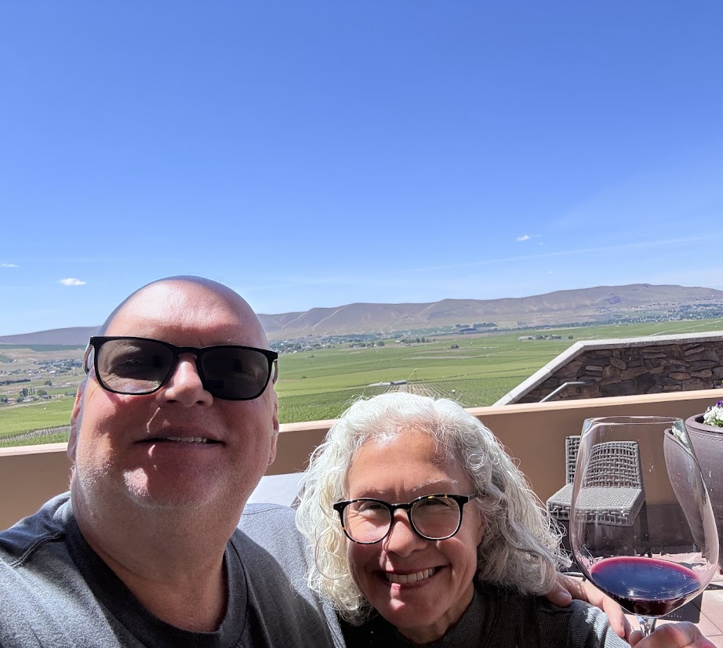
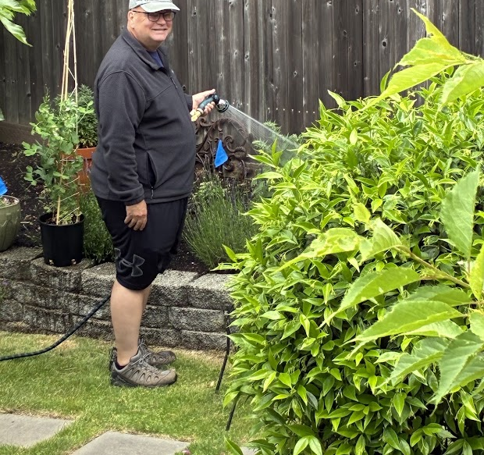
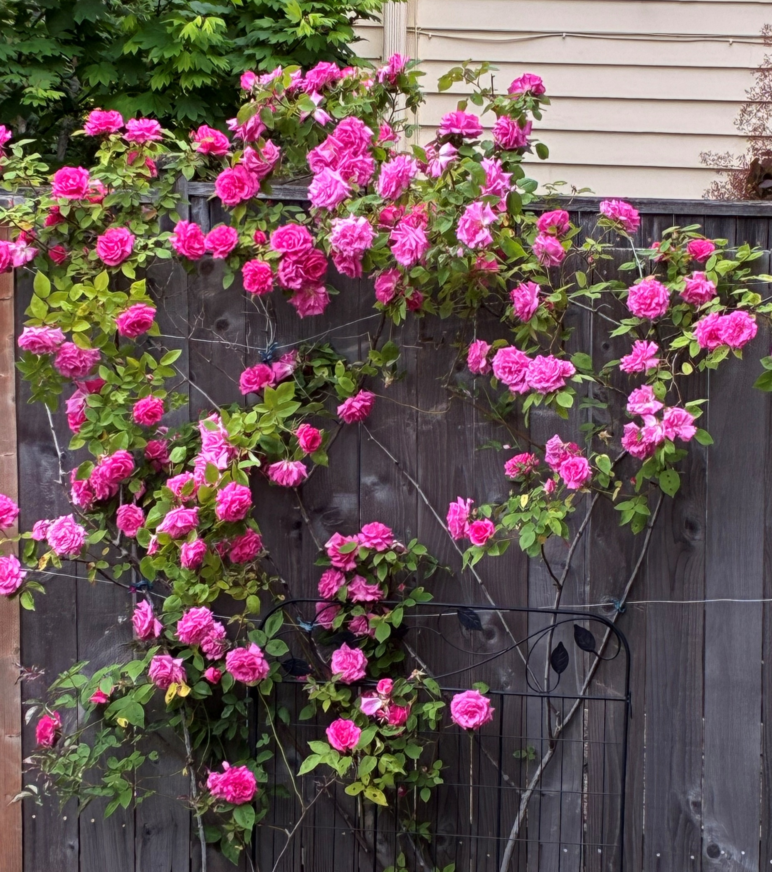
Returning Home…
Notes:
Gardening
Roses
Wine tasting out near Yakima (drive along river gorge), spent night riverside.

Slide 23
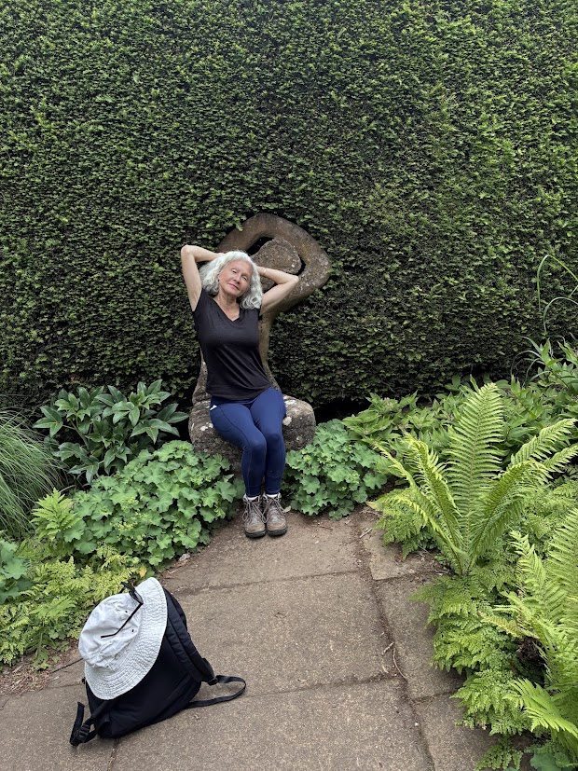


Late May: to England, Ireland and Scottish Highlands
Notes:
Kathy posing with wood statue of Daphne at Kiftsgate Garden in Cotswolds
Thatched roof modern home in Broad Campden, Cotswolds
Steve in court room at Kilmainham Gaol, Dublin

Slide 24



Notes:
Left fan family tree
My paternal great-grandmother:
Jessie Martha Dora Baughman
Birth: 7 Otober1884Dardanelle, Yell, Arkansas, United States
Death: 24 December 1916Dardanelle, Yell, Arkansas, United States
Jessie’s great-great grandfather, 1750, already in SC, but lots of Scots, Irish, and English heritage. (Scottish clearances were likely a part)
John Patton Sr
Birth: 1750 York, County, South Carolina
Death: 9 January 1809 Williamson, Tennessee, United States
James Butler
Birth: 28 May 1393Fruglasse, Kilkenny, Ireland
Death: 23 August 1452Ardee, County Louth, Ireland

Slide 25



Walking in the Cotswolds
Notes:
Cotswolds—cots= shelters, wold=hill. So shelters on the hilltops.
Rolling hill country with towns built upon wool industry which collapsed in 19th/20th C. Tourism now.
Strikingly beautiful, serene (mostly, with tourists and traffic now)
Friendly folks
This is one part of England where my ancestors lived before emigrating to British colonial America.
Agrarian south as tenant farmers.

Slide 26


Almshouses in Chipping Campden
Notes:
Endowed by Sir Baptist Hicks.
The Almshouses were built in 1612 at a cost of £1,000 to provide accommodation for six poor men and six poor women who were allowed a weekly allowance of 3s. 4d. and “a frieze gown and a ton of coals and a felt hat” annually. They still provide homes for twelve elderly people and remain much as they were, apart from the addition of a modern kitchen and bathroom rather than the original “one up, one down” layout with a shared outside privy.

Slide 27



Churches Visited
St. James’
“Wool Church”, Chipping Campden,UK
Bibury, England
St. Edward’s Church, Stow-on-the-Wold, UK
Notes:
St. James, Chipping Campden
Outdoor church at Bibury
St. Edward’s, Stow-on-the-Wold—major battle site in English Civil War (Digbeth Street)
also Tolkien’s inspiration for Doors of Durin in LOTR

Slide 28






Ireland with Siblings
Notes:
Belonging with family—spent more time with them these two weeks than in last forty years.
Dublin
Carrick-a-reke
Cliffs of Moher
Connemara mare and foal

Slide 29






Slide 30




Churches visited
Christ Cathedral, Dublin
St. Patrick’s Cathedral, Dublin
St. Anne’s Cathedral, Belfast
Notes:
Plus Kylemore Abbey in Connemara

Slide 31






Notes:
A Cloud of Witnesses?
Cemeteries or monuments to those who died—another way we forge the connections of belonging to those who’ve gone before
WWII Japanese soldier cemetery
Daviot Neolithic stone circle and cremation site
Connemara monument to those who died during Irish Famine
Hiroshima Peace Memorial
Cemetery in Mushashino, Tokyp
Family at Newgrange

Slide 32





Scottish Highlands
Notes:
Gem Cottage was on ancient churchyard near Firth of Cromarty. Was an 11th-16thC cathedral, now ruins with active churchyard cemetery and two houses outside walls of churchyard. Sheep farming around that.
Gem Cottage was on the footprint of the old deanery.

Slide 33




Notes:
Generational connections…
Pict stones with early Christian imagery
Fairy pools at Isle of Skye
Black Isle coastal walk
Block Rock Gorge (Harry Potter scene)

Slide 34


Midge protection at Skibo Castle
Notes:
All Trails suggested a 6-mile hike around a lake and up to a castle overlooking Dornoch Firth.
Swans, highland deer, lots of birds
Angus helped us along…

Slide 35



Churches visited…
St. Andrew’s Cathedral, Inverness, Scotland
St. Ninian’s, Invergordon, Scotland
St. Machar’s Cathedral, Aberdeen, Scotland

Slide 36
Museums visited…

Slide 37






Notes:
Queen’s University Belfast
Pict/Scot museum in Tain, Scotland
Book about the Scottish Clearances at Gem Cottage—Henry Wallace, The Stonebreaker
Scultpure at Tokyo Art Museum
Seattle Asian Art Museum
Archaeology Museum in Dublin—8thC bishop’s mitre

Slide 38



Sacred beauty here…
Notes:
Ladybug eating aphids on my roses at the deanery in spring
Fig tree at deanery leafing out
Japanese irises on walk on Cap Hill

Slide 39


This happened…Toussaint Amos Thomerly

Slide 40






Notes:
Sabbatical was fun also…
Ewe and lamb in Cotswolds
Fawn in Nara
Funny signs also

Slide 41

Summary and Conclusions
Grateful for the opportunity
Reflections will take time to unfurl fully
Benedictine practices: Stability, Obedience, Conversion
Belonging
  Family
  Community
  Humanity across time and space
  The Whole Creation (connection)
  God
Notes:
Stability: “accepting this particular community, this place and these people…as the way to God.” (finding God in current situation)
Obedience: “a lifelong process of learning…listening to the Word of God, to the Rule, t the brethren and to the Abbot” in order to act. (being present faithfully)
Conversion of Life: “a commitment to total inner transformation” as we turn to Christ. (opening into renewal/transformation)
-from Ester de Waal’s Seeking God.

Slide 42
Benedictine Patterns of Life
Stability
Obedience
Conversion of Life
Opening into
Transformation &
Renewal
Finding God in
the current situation
Being faithfully
present
Notes:
Stability: “accepting this particular community, this place and these people…as the way to God.” (finding God in current situation)
Obedience: “a lifelong process of learning…listening to the Word of God, to the Rule, t the brethren and to the Abbot” in order to act. (being present faithfully)
Conversion of Life: “a commitment to total inner transformation” as we turn to Christ. (opening into renewal/transformation)
-from Ester de Waal’s Seeking God.
Rowan Williams: “

Slide 43
The Wisdom of Wendell Berry…
“And the world cannot be discovered by a journey of miles, no matter how long, but only by a spiritual journey, a journey of one inch, very arduous and humbling and joyful, by which we arrive at the ground at our own feet, and learn to be at home.”
― Wendell Berry, The Unforeseen Wilderness: Kentucky's Red River Gorge

Slide 44
Upcoming Cathedral Commons
16 Sep.
A Spirituality of Suffering and Solidarity
23 Sep.
Special Parish Forum: Design Committee and Project Updates
30 Sep.
Solidarity in Suffering: The Martyrs of Memphis, Frances Perkins, Jonathan Daniels, and Pauli Murray
7 Oct.
Visual Storytelling Project (Affordable Housing)
Notes:
9/16- How are we to respond to human suffering in our time? What does solidarity with those who are suffering look like? What does compassion, meaning ‘to suffer with,’ really mean in a world that has erected all sorts of diversions—the economies of war, wealth disparities, and constant entertainment? If we are created in God’s image, and if there is so much suffering in the world, then God, too, must be suffering.
9/23—Meet the Team—Abbott Construction, Architect, Owner’s Rep, SMC Design Team

