Slide 1
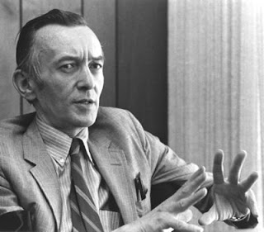
William Stringfellow: Prophet of Justice, Prophet of Life
Our plan for the evening:
Biography (story shapes theology)
Stringfellow’s Moral Theology: A Sketch
Digging Deeper
What Do We Do With This?
Notes:
Slide 1

Slide 2
Who was William Stringfellow?
A prophet
A theologian
A lawyer
A lay Episcopalian
An agitator
An advocate
A social critic
A circus connoisseur
“A parable before the powers.”
-- Wm Stringfellow’s description of a Christian
Notes:
Slide 2
We’ll unpack “A parable before the powers” a bit later
Parable – story/life/biography and theology. Fundamentally an incarnational view. Life in Christ.

Slide 3
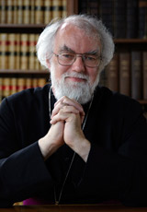
Even Rowan Williams is a fan…
Impossible to classify
Passionate radical without being a radical idealogue
Critic of reducing Christian faith to social service
Proclaimer of Biblical authority
Prophet for the church
Espouser of Biblical models for ruling authority
Notes:
Slide 3.
Read portions of Williams forward to An Alien in a Strange Land – blue tab

Slide 4

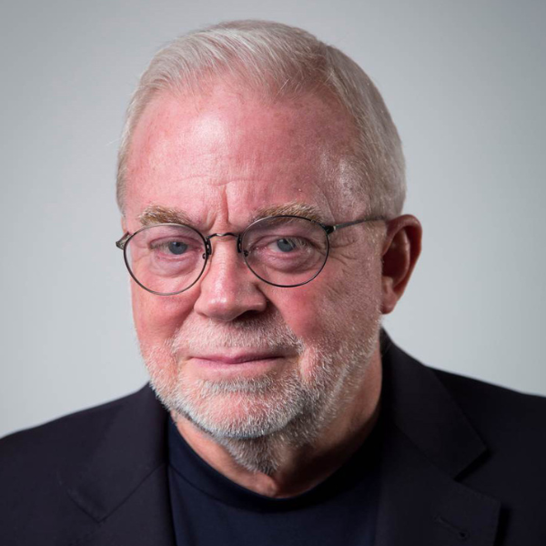
Reflection from Jim Wallis
“He always spoke from the Bible, and, from my first hearing of William Stringfellow, I felt that the Word of God was being opened up to me. The way he explicated the scriptures caused a deep esxcitement within me… In my opinion, [Stringfellow] was the most significant U.S. theologian of the last three decades.”
Notes:
Slide 4.
Read excerpts from Sojourners article – Jim wrote in 1985, one year after Wm St death

Slide 5
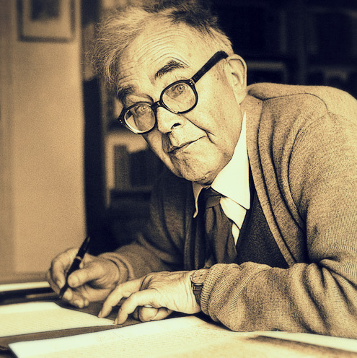
Others’ views on Stringfellow…
“This is the man America should be listening to.”
--Karl Barth
Notes:
Slide 5.
Karl Barth: theology grounded in scripture. Shocked the liberal German theological establishment with his insistence on a return to authentic Biblical study and theology. Also authored the Barmen Declaration – the Confessing Church statement at total odds with the state church apparatus during Nazism in the 1930s. Bonhoeffer very involved in Confessing Church. Ties to Stringfellow

Slide 6
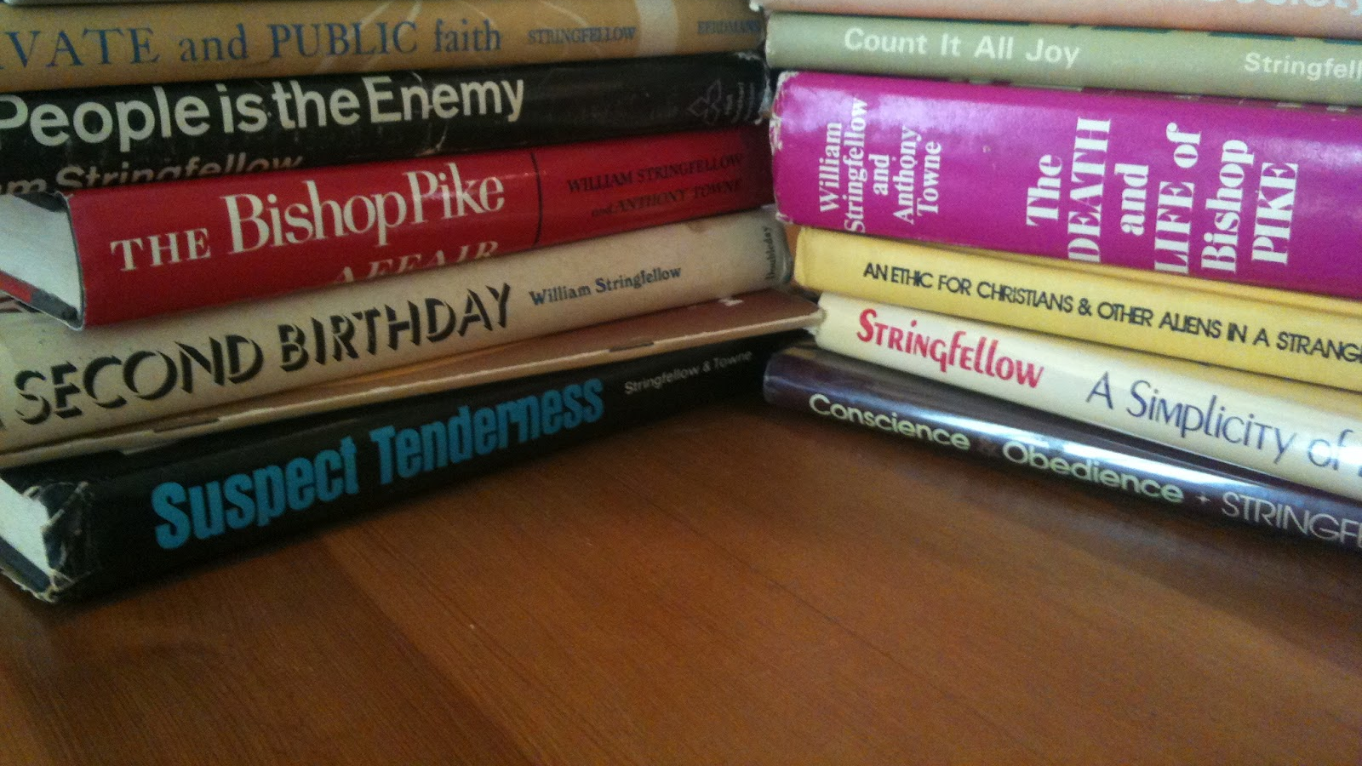
Reflection Question
What Christian prophet grabs your attention today?
Notes:
Slide 6
Stringfellow often referred to as a prophet.

Slide 7
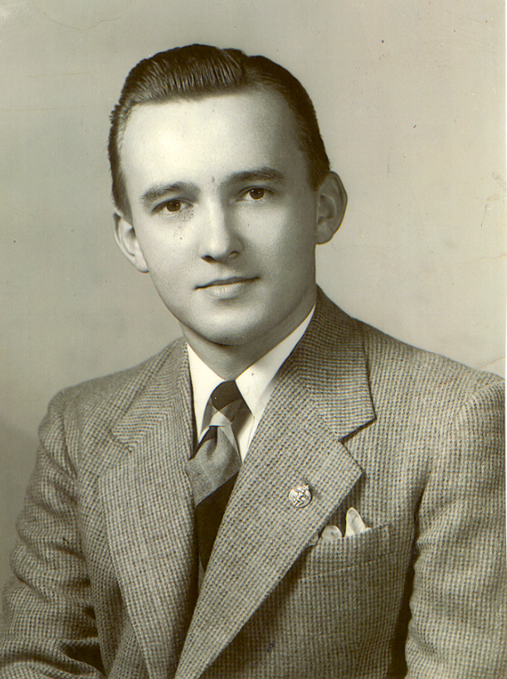
Early Life
Born in 1928 in Johnston, Rhode Island
Clear calling to lay ministry – age 14
Raised Episcopalian during the Great Depression
Education:
  Bates College, Maine
  London School of Economics
  (Episcopal Divinity School)
  Harvard Law
Notes:
Slide 7
Age 14 – encouraged to be a priest, S clearly discerned that was not his call. A distrust of institutions was already germinating.
1947 – Traveled to Oslo for Second World Council of Christian Youth. Heard Reinhold Niehbur among others – lifelong association with major theologians
Bates – as a junior he organized a sit-in at a local restaurant that refused to serve people of color. He never looked back.
LSE – influenced by William Temple, socialism, Anglo-Catholicism (economic practices for justice shaped and nurtured in faith)
EDS – studied for a while, didn’t take a degree there, but was shaped by its early progressive activism and later in life with its support for Philly 11
Served two years in the army as law clerk prior to Harvard

Slide 8

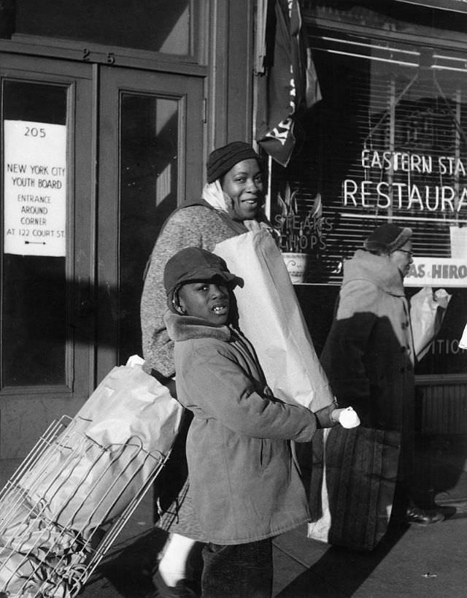
1950s Harlem
Calling to live amongst the poor – not as a savior
East Protestant Episcopal Parish
How did Stringfellow build trust?
Visit from Monk
Sacrament of the jacket
Notes:
Slilde 8
Calling to live amongst the poor – not as a savior
East Protestant Episcopal Parish
How did Stringfellow build trust?
Read passage from My People is the Enemy
Visit from Monk
Sacrament of the jacket

Slide 9

1960s Manhattan
1962 U. Chicago symposium
  Karl Barth
1962 meets Anthony Towne
  World Council of Churches party
1962 A Private and Public Faith
Notes:
Slide 9
Tours Barth through Harlem (as “safe” guide)
Symposium panel – Stringfellow’s questions at least as interesting as Barth’s answers
“This is the man America should be listening to”
Anthony Towne – bartender at WCC party in Manhattan. Both got drunk (S. quit in 1968).
Stringfellow helped Towne delay an eviction, after which they moved in together on the upper West Side
Towne was a Methodist minister and poet, helped co-author books later with S.
A Private and Public Faith
S. begins coming out with his theology
A prophetic call to the church, particularly the protestant church, to return to the Word of God, to be active in the world where justice is called for, to cease being complicit in structures of power, privilege, and wealth
An early push back against an enculturated church of Christendom
Delineates the importance of all orders of ministry, articulating lay ministry
Universal understanding of the action of Christ’s Body in the world
READ CLIP

Slide 10
Late ‘60s & ‘70s
Publishes almost one book per year, many speaking engagements
Summer 1966 - joins a circus with Anthony Towne
  Circus as a theological metaphor, a container for assigned meaning*
1967 – moves to “Eschaton” on Block Island, RI, with Towne
1968 – Rare illness progresses, quits drinking, radical surgery
1968 – Guggenheim Fellowship to write American moral theology
Notes:
Slide 10
*Commins, Gary. “Death and the Circus: The Theology of William Stringfellow,” ATR vol. 79 issue 2.

Slide 11
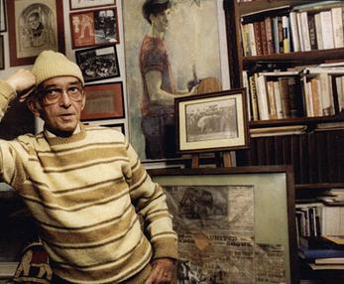

“Eschaton,” Block Island, Rhode Island
Notes:
Slide 11
“Eschaton” on Block Island, RI - His home a metaphor for the eventual junction between history and the Reign of Christ

Slide 12

You, too, can be William Stringfellow…
…and not only on Halloween!
With thanks to the Rev. Fr.
McKenzi Roberson
Notes:
Slide 12 - McKenzi!

Slide 13
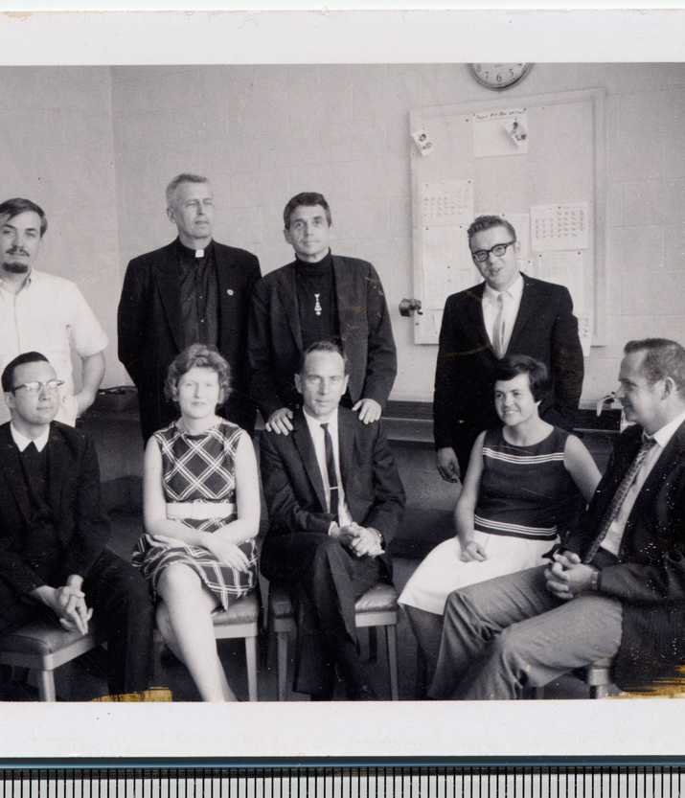
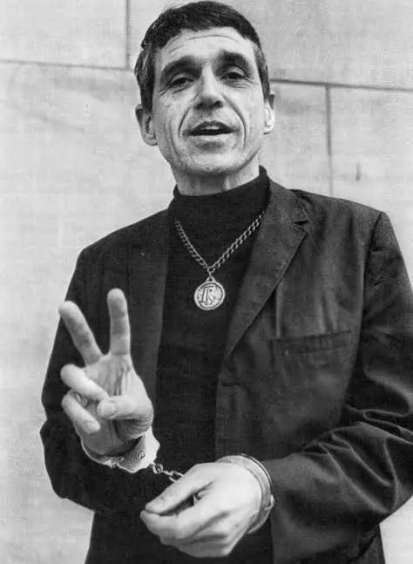
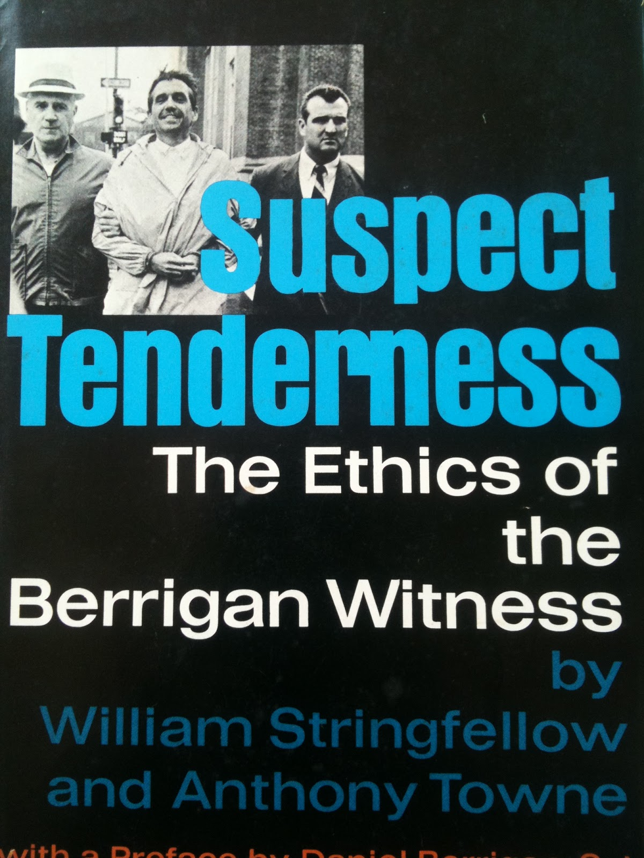
The Catonsville Nine & Fr. Daniel Berrigan
FamilyID=Office_ArchiveTorn
Notes:
Slide 13.
1967 - Daniel & Philip Berrigan and seven other Catholics (Maryknoll sisters & brother, lay people) raid a Selective Service office in Catonsville, Maryland
Burned the draft cards on the front lawn with homemade “napalm” and recorded it
Arrested and tried in 1968, found guilty – 18 years’ prison between all of them, $22K fines
Berrigan failed to show up for his sentencing
Went on the run – causing considerable embarrassment to the FBI. He’d give sermons at various places all over the country, and leave right after the service and be gone before authorities arrived
Several such “appearances” – he was convinced he could have a bigger impact for his Xn values out of jail
1969 he takes refuge with Stringfellow and Towne on Block Island – Stringfellow had a cottage built for him with a view of the Atlantic
1970 the gig is up – he’s arrested
Stringfellow and Towne charged with harboring a fugitive. Charges later dropped.

Slide 14
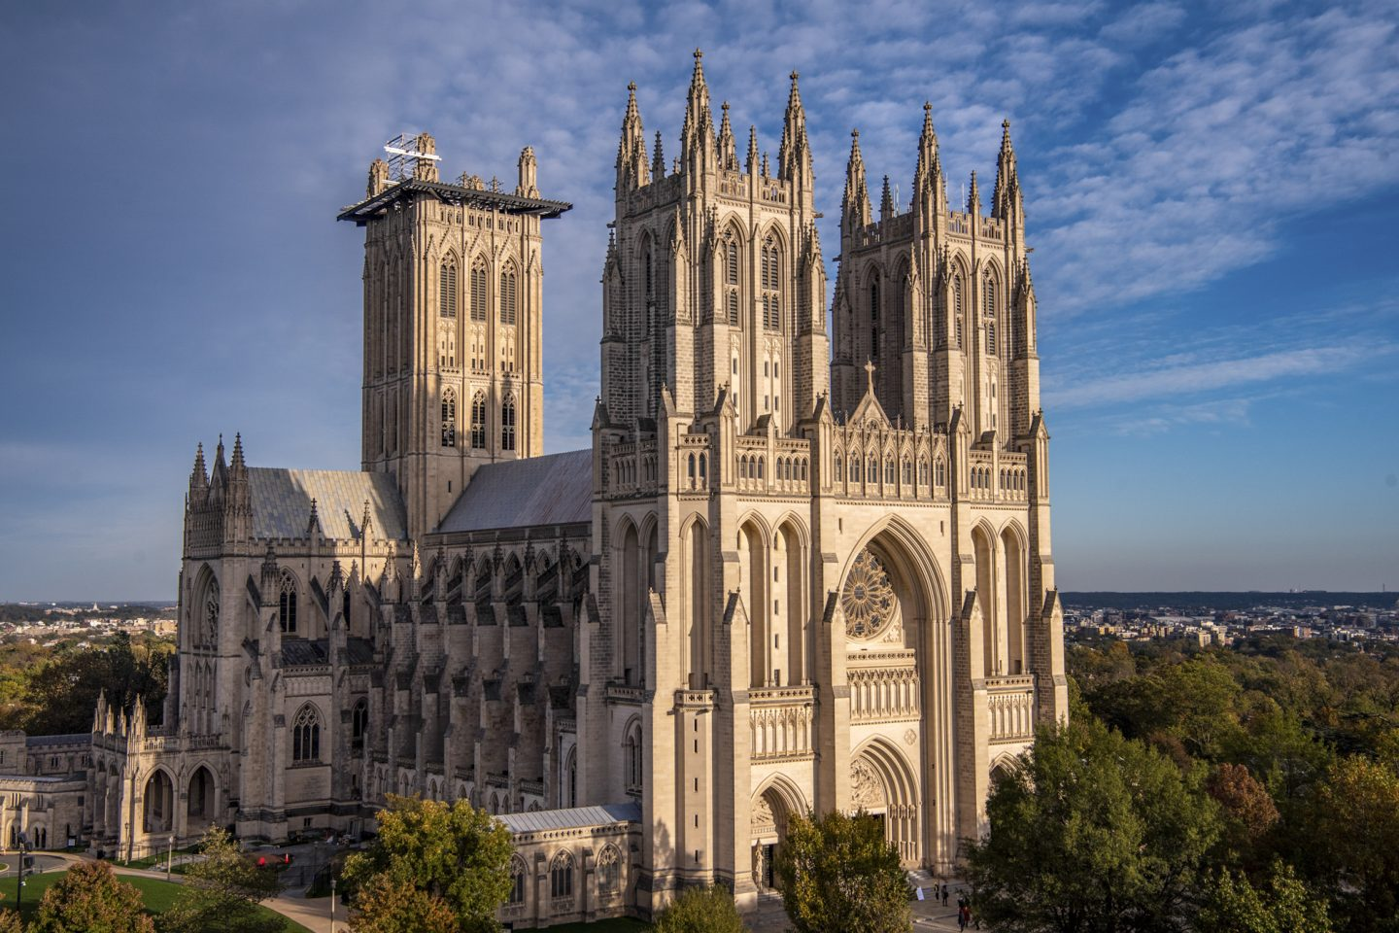
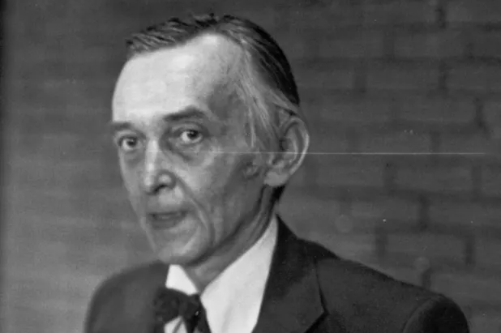

1970s
1970 – Arrest of Berrigan & criminal charges
1973 – Ethic for Christians and Other Aliens in a Strange Land
1976 – Defense of William Wendt & Philadelphia Eleven
Notes:
Slide 14
1972 – Stringfellow gives sermon advocating for the arrest of President Nixon
1973 – Ethic for Christians and Other Aliens in a Strange Land
Develops major themes. Written for Americans who feel estranged – or should – from their own country. Don’t recognize it.
ADVANCE SLIDE & COME BACK (Philly 11)
1976 – Canonical lawyer for William Wendt, canonical trial at Nat’l Cathedral for priest who violated canon law by allowing an “irregularly ordained” woman to celebrate
READ QUOTE – Sojourner’s article – “Perchance, there is another way…

Slide 15
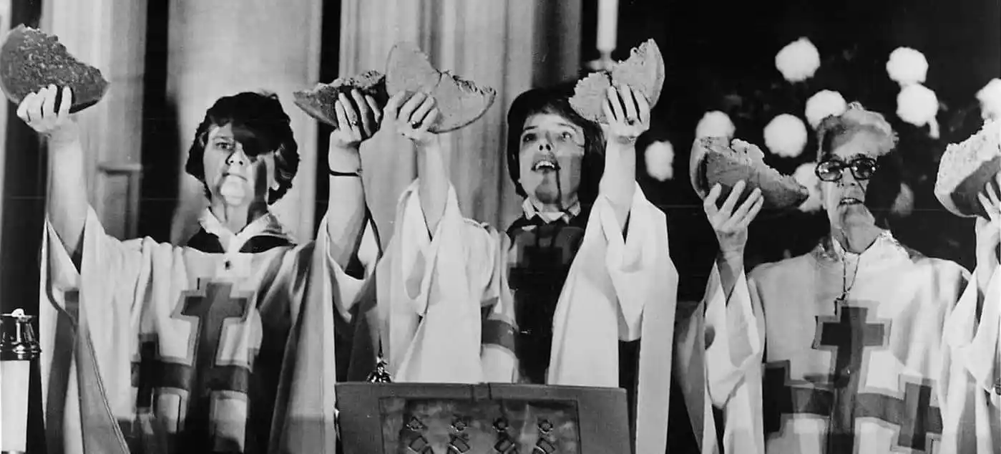
The Philadelphia Eleven
Notes:
Slide 15. – Philly 11

Slide 16
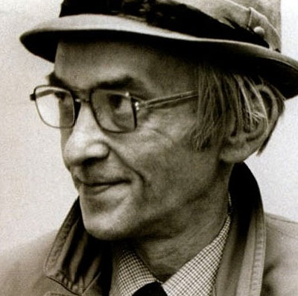
Late 1970s & 1980s
1976 Instead of Death
1977 Conscience and Obedience
1980 Anthony Towne dies suddenly
1982 A Simplicity of Faith: My Experience in Mourning
1984 The Politics of Spirituality
1985 Stringfellow dies
Notes:
Slide 16

Slide 17
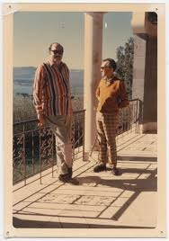
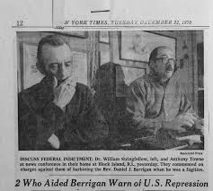
William Stringfellow & Anthony Towne
Notes:
Slide 17
Stringfellow’s homosexuality
Not really hidden, but never made public, official
Different era
Friends all knew – and knew well
Stringfellow had some ideas about sex when he was younger that were archaic, he otherwise didn’t write much about it.
It’s clear they were very close – even in his book on mourning, he’s slightly vague on certain specifics, but clearly in love with this man

Slide 18
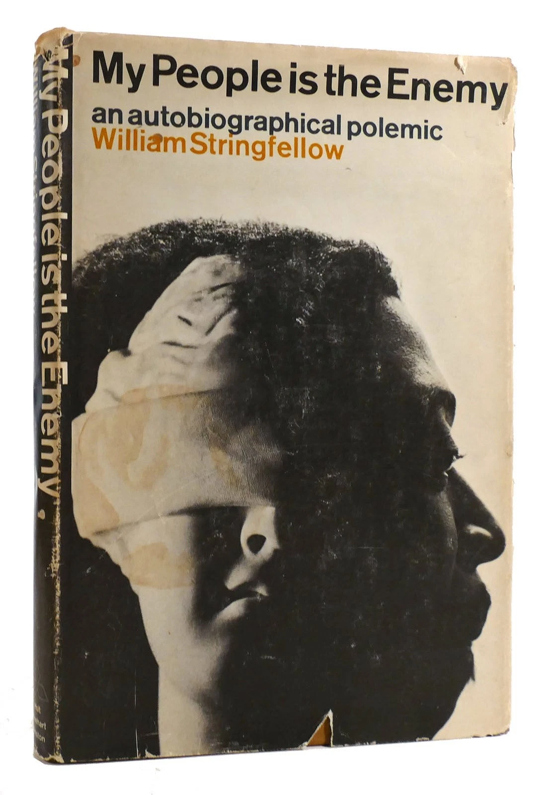
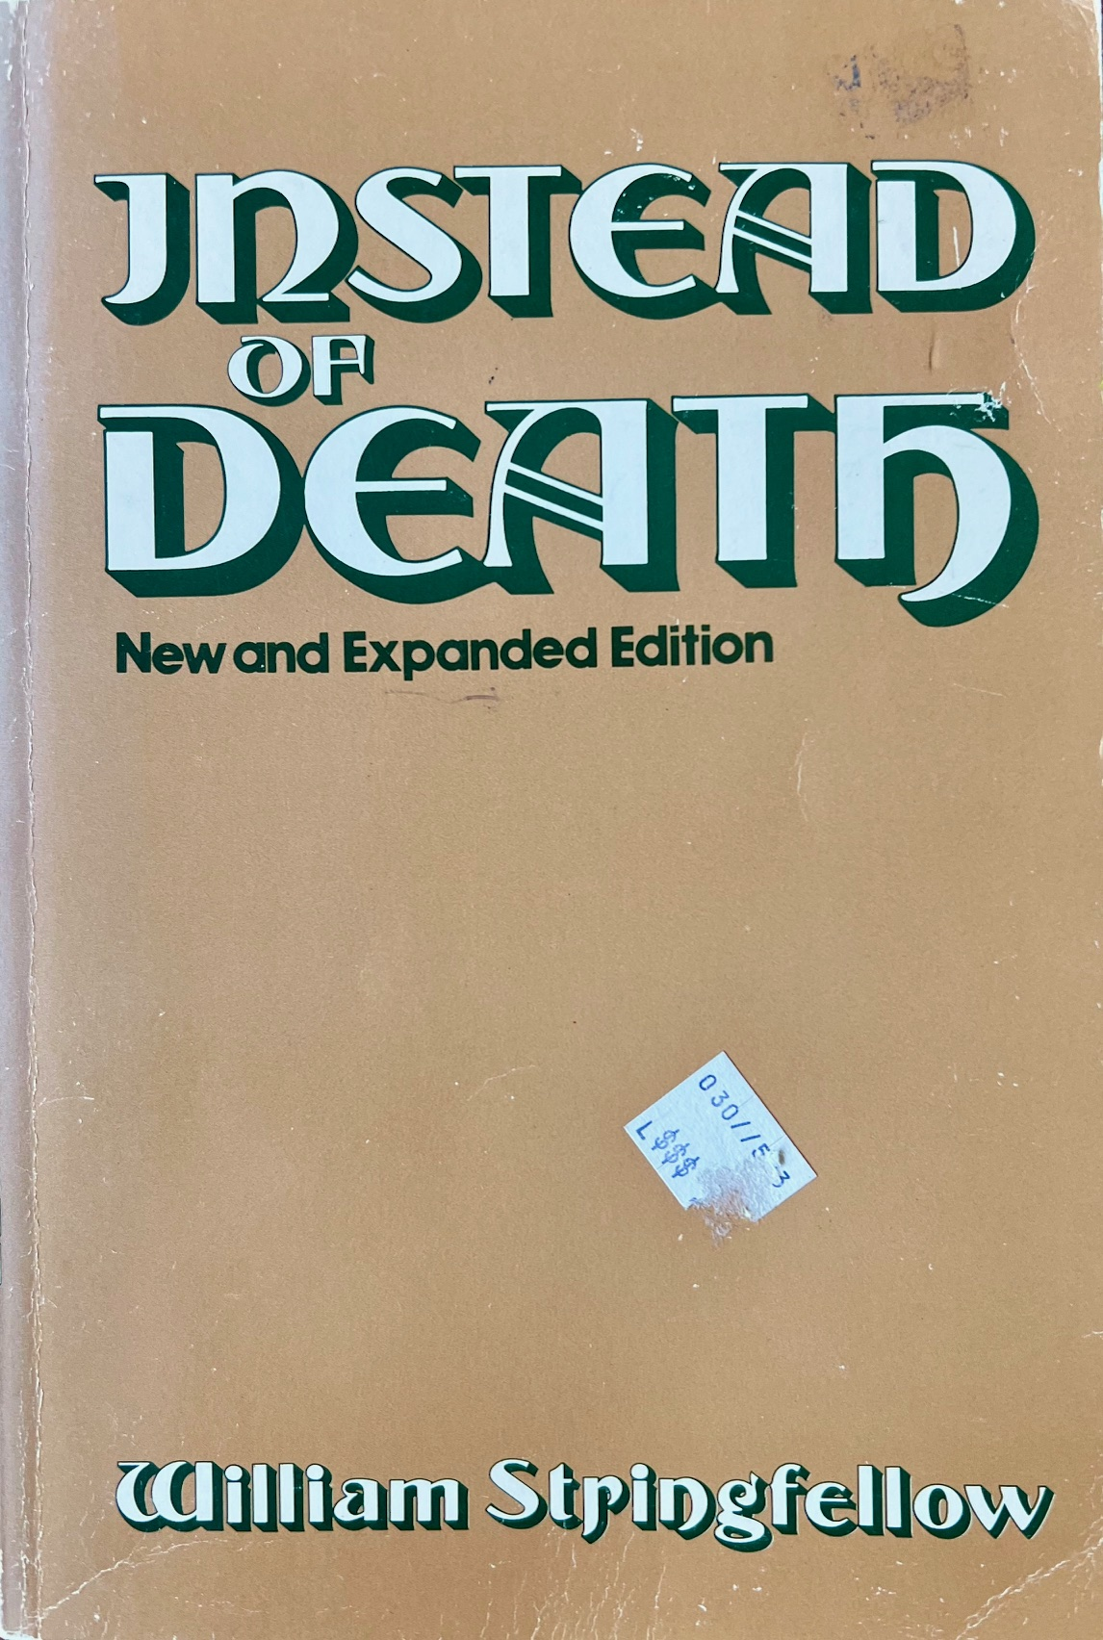
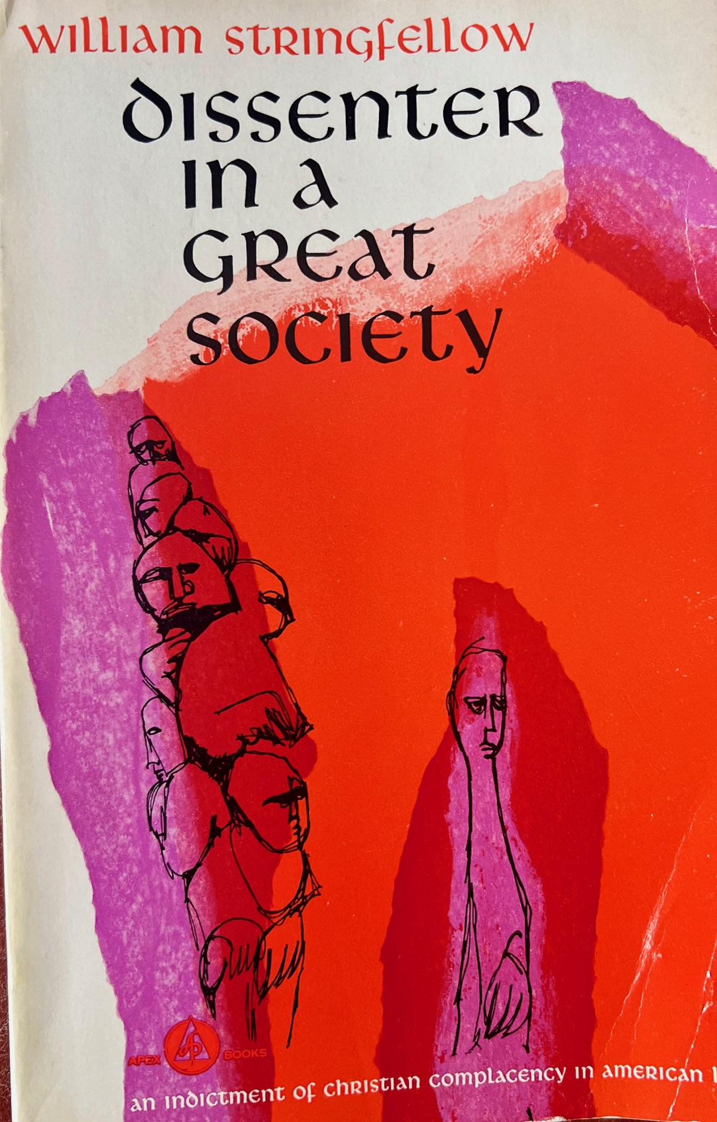
Stringfellow’s Theology:
Christ and the Power of Death
Notes:
Slide 18
Major themes in Stringfellow’s theology - - traced through his 1960s major works
My People is the Enemy
Reflection on Harlem experience and racism
“No white man [person] is innocent”
Racism is a Principality … more on that later
Instead of Death
Originally draft written for youth and young adults
Death as the greatest power in the world
Loneliness and death
Loneliness and Christ
Prayer & Worship
Prayer Quote
Baptism – sacrament of unity
Dissenter in a Great Society
Unpacks what makes the United States a power oriented towards death
Principalities
Racism
Money
War against the poor
Waste
Corruption
Inefficiency
Technology as panacea (devoid of Xn witness)
WASPS and the prospect of American Totalitarianism
Unity of baptism – p. 147
Liturgy as a Political Event - p. 152
Liturgy of gospel dramatic form of the ethical witness of Xns in this world
Both transcendent and present – shattering categories of time and space
Recollects all that has happened and prophesies all that is still to come
Also contemporary reality – an action of reconciliation between, within, and among themselves and the rest of the world.
“A normative and conclusive ethical commitment to the rest of the world.”
A REAL shared meal – sacramental nourishment with Christ as host to the world. P. 54
“The Liturgy is social action because it is characteristic style of life for human beings in this world.” p. 154

Slide 19
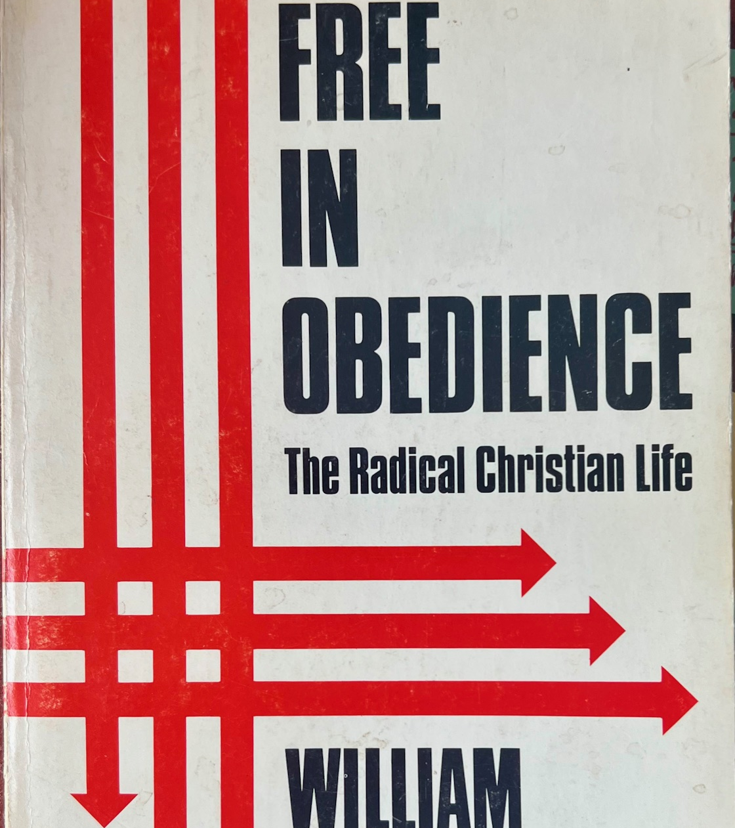
Not Good vs. Evil, but Death vs. Life
Notes:
Slide 19
Free in Obedience
S. develops the substantive core of his practical theology (not a systematic theologian)
Chapter – the Scandal of Palm Sunday
Here the disciples are the stand-in for the devil in a repeat of the wilderness temptations
In the wilderness, “death departs from him until an opportune time[sic].”
They did not fully know Christ. They were expecting kingship, power, glory – this is in the parade and entry to Jerusalem
READ QUOTE: “Let us not be too harsh on the disciples…”
Return to chapter to discuss Witness – what/how to take ACTION in the world. P. 40 ff (A.I./tech question answered, too)
Chapter – Christ and the Powers of Death
S. uses NT language – it’s most helpful
Not only Powers & Principalities, but demonic
What is demonic is not so much evil, but oriented toward its own death
Death is about estrangement, from authenticity, from Christ – this is demonic
Devilish – one does not have to believe in anthropomorphic figures with red horns to see the reality of the devil as death in history
In the name of these powers, X is put on trial (empire, etc.)
Accused of subverting and undermining the nation, its existence, survival, and destiny
Of the charges against him, X is guilty beyond all doubt
The most decisive clash in history is b/n X and the principalities and powers of this world, symbolized by Israel & Rome
What are principalities?
Institutions, images, ideologies
A living reality – distinguishable from human and other organic life, but not without a life of its own
Humans have and can be images, however
All of us have images of ourselves – idolatrous fictions for the world
Sometimes these can rise to the level of principalities – c.f. Adolf Hitler
Here’s the hardball out of left field – these are made by God, not men, they are created for good
The authentic human Adolf Hitler had been wholly obliterated by the principality of Hitler
Hitler was not the work of some dark genius of a man, but of the demonic power that possessed him – not his true self
Principalities make claims upon us
By absorbing us into their only focus – survival
Self-preservation is death-orientation
They are demonic – deathward focused
They deny God’s sovereignty
They corrupt our humanness
They compete for the attention and lives of human beings
They promise salvation and command our allegiance
They claim to offer meaning and purpose, fulfillment in life
In reality, they are a source of bondage toward death
They are consigned to death, as are the people who “live” for them
Ideologies
All closed systems are problematic
Self-referenced, self-focused
Communism, fascism, racism,
Current example: White Christian Nationalism
How is Christian Nationalism an ideology concerned with its self-preservation, and by extension, its death?
READ QUOTE p. 58
Story about Andy Thompson’s class –
Stringfellow was generally considered a progressive Christian
Surprised to know he was a critic of liberation theology
In some sense, it doesn’t go far enough
Critique
It isn’t explicit in terms of being anchored in the corporate praxis of the Body of Christ
Its absorption of a closed ideology – Marxism – makes it toxic, concerned with its own survival in a sense, not oriented fully toward Christ
Can agree or disagree
Christ’s resurrection defeats death once and for all
Not only at the terminal point of a person’s life, but in their life right here and right now – this is significant
We can live for Christ, we can live for life, right here, right now
We’ll look at how to do that a little more in a minute

Slide 20
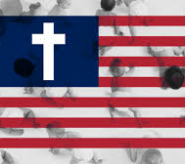
Core Theme: Death
Notes:
Slide 20
Death v. Life, not good v. evil, fallen, not evil
Death = turning away from Christ to affect self-survival (also described as demonic)
Death = Alienation, Estrangement
Fundamental disposition in this world
Disordered relationships – oriented toward death
Captivity to the Powers & Principalities – institutions, idols, and ideologies
These want our attention, but they are oriented toward death. They kill here and now
Blasphemy: Conscience and Obedience
As to Romans 13, obey, etc., see also Revelation 13: “Men worshipped the dragon, for he had given his authority to the dragon – a beast rising out of the sea”
There is blasphemy against life in death
As a prophet, Stringfellow calls the church, calls you and me, not into an idealized future or forward casting vision
It’s a call of return
Return to original relationship
True selves in Christ
Resurrection
Life in Christ offers reconciliation from estrangement
Interestingly, not just for humans, but for all of creation
Even institutions can be reoriented with discernment and moral VIGILANCE
Jonathan Rauch and Xty as a bulwark, a “load-bearing wall” to civil, peaceful society
But this can’t be relied upon outside of Christian witness
Daily task
This is our call to faithfulness

Slide 21
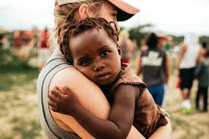
Core
Theme:
Incarnation
Notes:
Slide 21
INCARNATION
Reject division b/n sacred and secular, spiritual and political
Life in the world is not separate from life in the church on Sunday morning
One without the other is unsustainable
God “participates” in life through us
The Xn must fully participate in the world – marketplace, political arena, neighborhood
Life in X is inherently political
Real world implication for how we relates to others
To live at the expense of others isa moral choice – made manifest only through the fall – Deathward oriented
Everything we do has a moral impact
Can’t undo this until the Reign of God is fulfilled, but in the meantime, we are called to
Faithfulness
Discernment
Not every Xns call to faithfulness will present necessarily the same answer to any given question or event. This is because we move in sacramentality, in incarnation – we don’t begin with pietistic or moralistic programming, but we begin and end in Christ

Slide 22
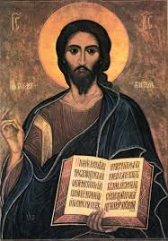
Core Theme: Word
Notes:
Slide 22
Take this very seriously:
“The Word of God is free and active in the world”
Word of God is God
Rather than allowing notions of God to be a cipher for what we fill in with self-serving preconceptions
Initiative rests with God
God is speaking to us – we learn to listen, we don’t really know how to speak about God (certainly imperfectly)
Bible as words of God mediate the Word of God, but the Bible is not an end in itself – this is idolatry
Take the bible seriously, not literally (this is not serious)
The Word of God is mediated through scriptural text – speaking through living scripture
“Christians have a simple responsibility to their fellow members in Christ to maintain in the forms of their worship an integrity to the gospel. This is in itself a sufficient reason for Christians to continue to uphold forms of worship which are the common sacraments of the Christian life, that is, Baptism, Holy Communion, and the Preaching nof the Word in the congregation.” -- The Xn Lawyer as Churchman, 1957
Liturgy is a political event
Word of God is not limited by anything, including culture
West Side Story
Theology in story
Estrangement – Italian and Puerto Rican gants
Fight – death
Out of death, two are reconciled
This is the Gospel of Jesus Christ
Mandelorian story – VTS lost video

Slide 23
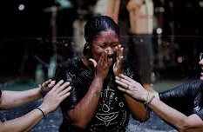
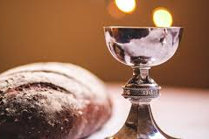
Core Theme: Sacrament
Notes:
Slide 23
Church’s witness in the world is sacramental, not moralistic or programmatic
Not about “goodness,” or “righteousness,” or “piety.”
Rather, about living humanly in the Fall
We can’t fully escape our complicity with evil – that is, with death, but we can live as a
SIGN OF LIFE AND LOVE in the world
A conduit for God’s love
Christ claims us in this world through the sacramental worship of the church
Baptism
BAPTISM IS THE SACRAMENT OF THE LAITY!!!
“Baptism is the assurance == accepted, enacted, verified, and represented by Christians – of the unity of all humanity in Christ. The baptized are the people in history consecrated to the unity humans receive in the worship of God.” -- Instead of Death 111
Read quote
“Baptism overcomes all that alienates, segregates, divides and destroys men in their relationships with each other, within their own persons, and in their relationship with the rest of Creation.” 112
& Christ nurtures us for action in the world
Eucharist - encounter and contact

Slide 24
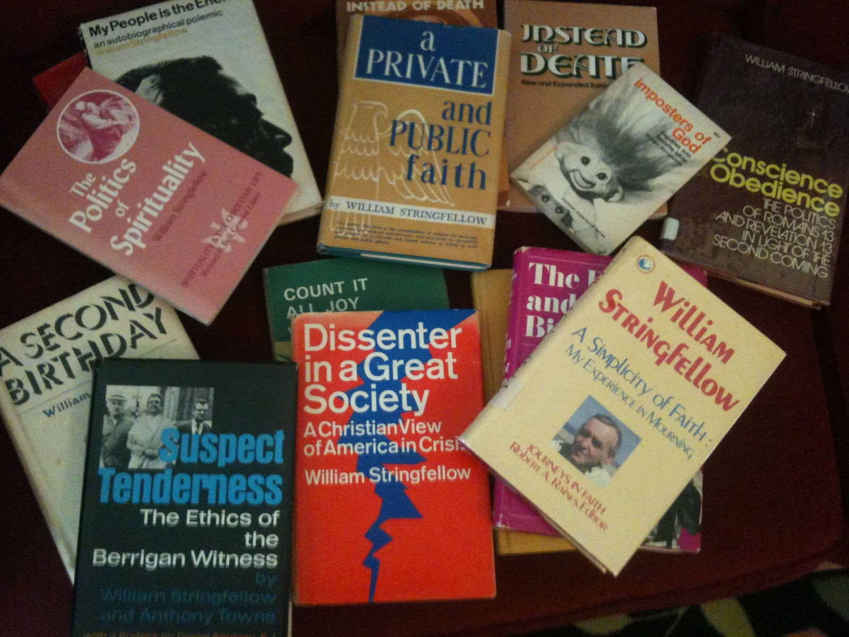
What do we do with this?
Live humanly
Notes:
Slide 24
“This is the awful freedom into which the Church is born and into which the Christian is baptized. It is a freedom to live in this present age, during the remaining time of death’s apparent reign, without escaping or hiding or withdrawing from the full reality of death’s presence, bearing the brunt of its powers, yet jubilantly confident at the same time of Christ’s victory over death and all the powers of death.” – Free in Obedience, p. 75
To live humanly is to live according to:
Discernment
Faithfulnes
To resist the power of death
Affirm the Biblical life
Take scripture seriously
Live baptismally, review your vows and promises – “Remember your Baptism” (see 111 – 112 “Instead of Death”
Example of life in Nazi Germany – this is tough
Resistance was the only way to live
Coveting safety, security, invisibility – these are idols in the face of a deathward reign of terror
Not to resist involved the certainty of moral death, of losing true humanness
Where is the Word of God in your life?
Where are you part of, or able to contribute to reconciliation? Where is your West Side Story?
Where is your gospel truth emerging from death, from estrangement?

Slide 25
Reflection Question
How are you called to live humanly today?
Notes:
Slide 25

Slide 26
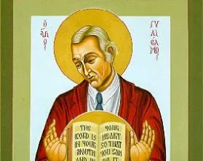
“But be doers of the word, and not hearers only, deceiving yourselves.”
James 1:22
Notes:
Slide 26
Irony – Stringfellow as an icon. Wouldn’t have liked that, but I’m more with John Chrysostom on that

